Slide 1
Stats Review

Slide 2
Discrete vs. Continuous Variable
Discrete Variable
Data can only take on certain individual values
Book page: 1, 2, 3, … (cannot be 1.5)
Shoe size: 5, 5.5, 6, … (cannot be 5.4)
Number of people (cannot be 0.25 person)
Continuous Variable
Data can take on any value in a certain range
Height: 175.264795 cm
Weight: 68.4456 kg
Volume: 500.0122 ml

Slide 3
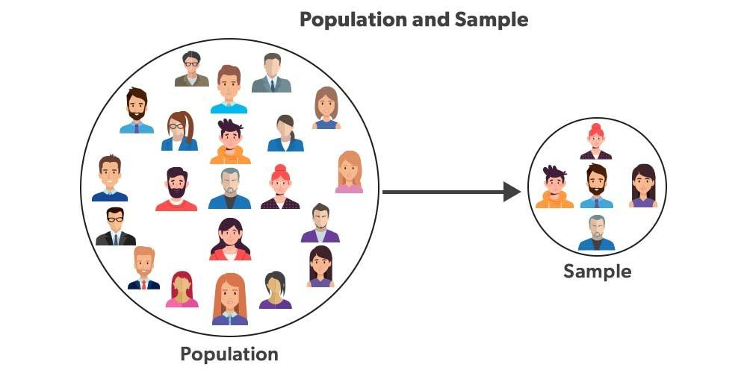
Population vs. Sample
Population is the entire group of things we want to draw conclusions about, while sample is only a part of the group we choose to represent the entire group.

Slide 4
Let’s run a beer company! 🍺
We are selling a glass containing 500ml of beer. However, since the volume of the beer is a continuous random variable, it is impossible to get exactly 500.000000… ml.
500ml
If we put in more than 500ml, the customer will be happy. However, we will lose profit.
500ml
If we put in less than 500ml, the customer will call us a cheater. We will lose customers, which means we will also lose profit.
The question is how will we test to make sure that our beer is around 500ml?

Slide 5
Population vs Sample 🍺
If we measure every glass of beer (the population), we would be sure that every glass will be around 500ml, but:
  It is very time consuming.
  Requires a lot of man-hour or more expensive technology for inspection.
  These are costs, which again, reduce the profit.
This is where sampling comes in. We only need to sample some of the glasses, to make sure most of the glasses are around 500ml.
  less cost means higher profit!
However, we need sampling methods to make sure that our sample represents every glass we produced.

Slide 6
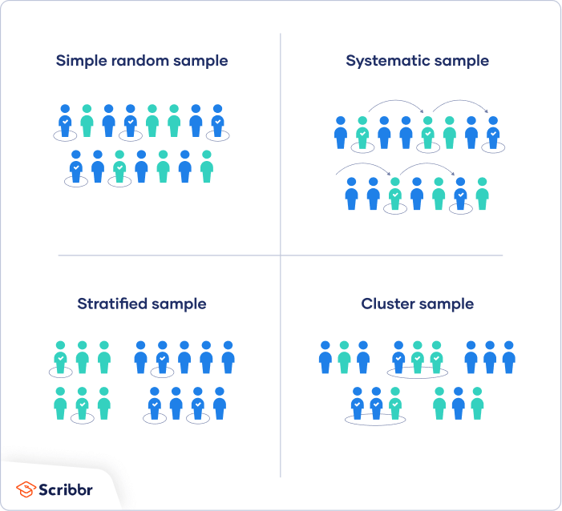
Sampling Methods 🍺
Randomly selects n glasses
Selects 1 every X glasses

Slide 7
Sampling Methods 🍺
Separate beers into categories, then randomly selects from each category
Separate beers into groups, then selects only some groups

Slide 8
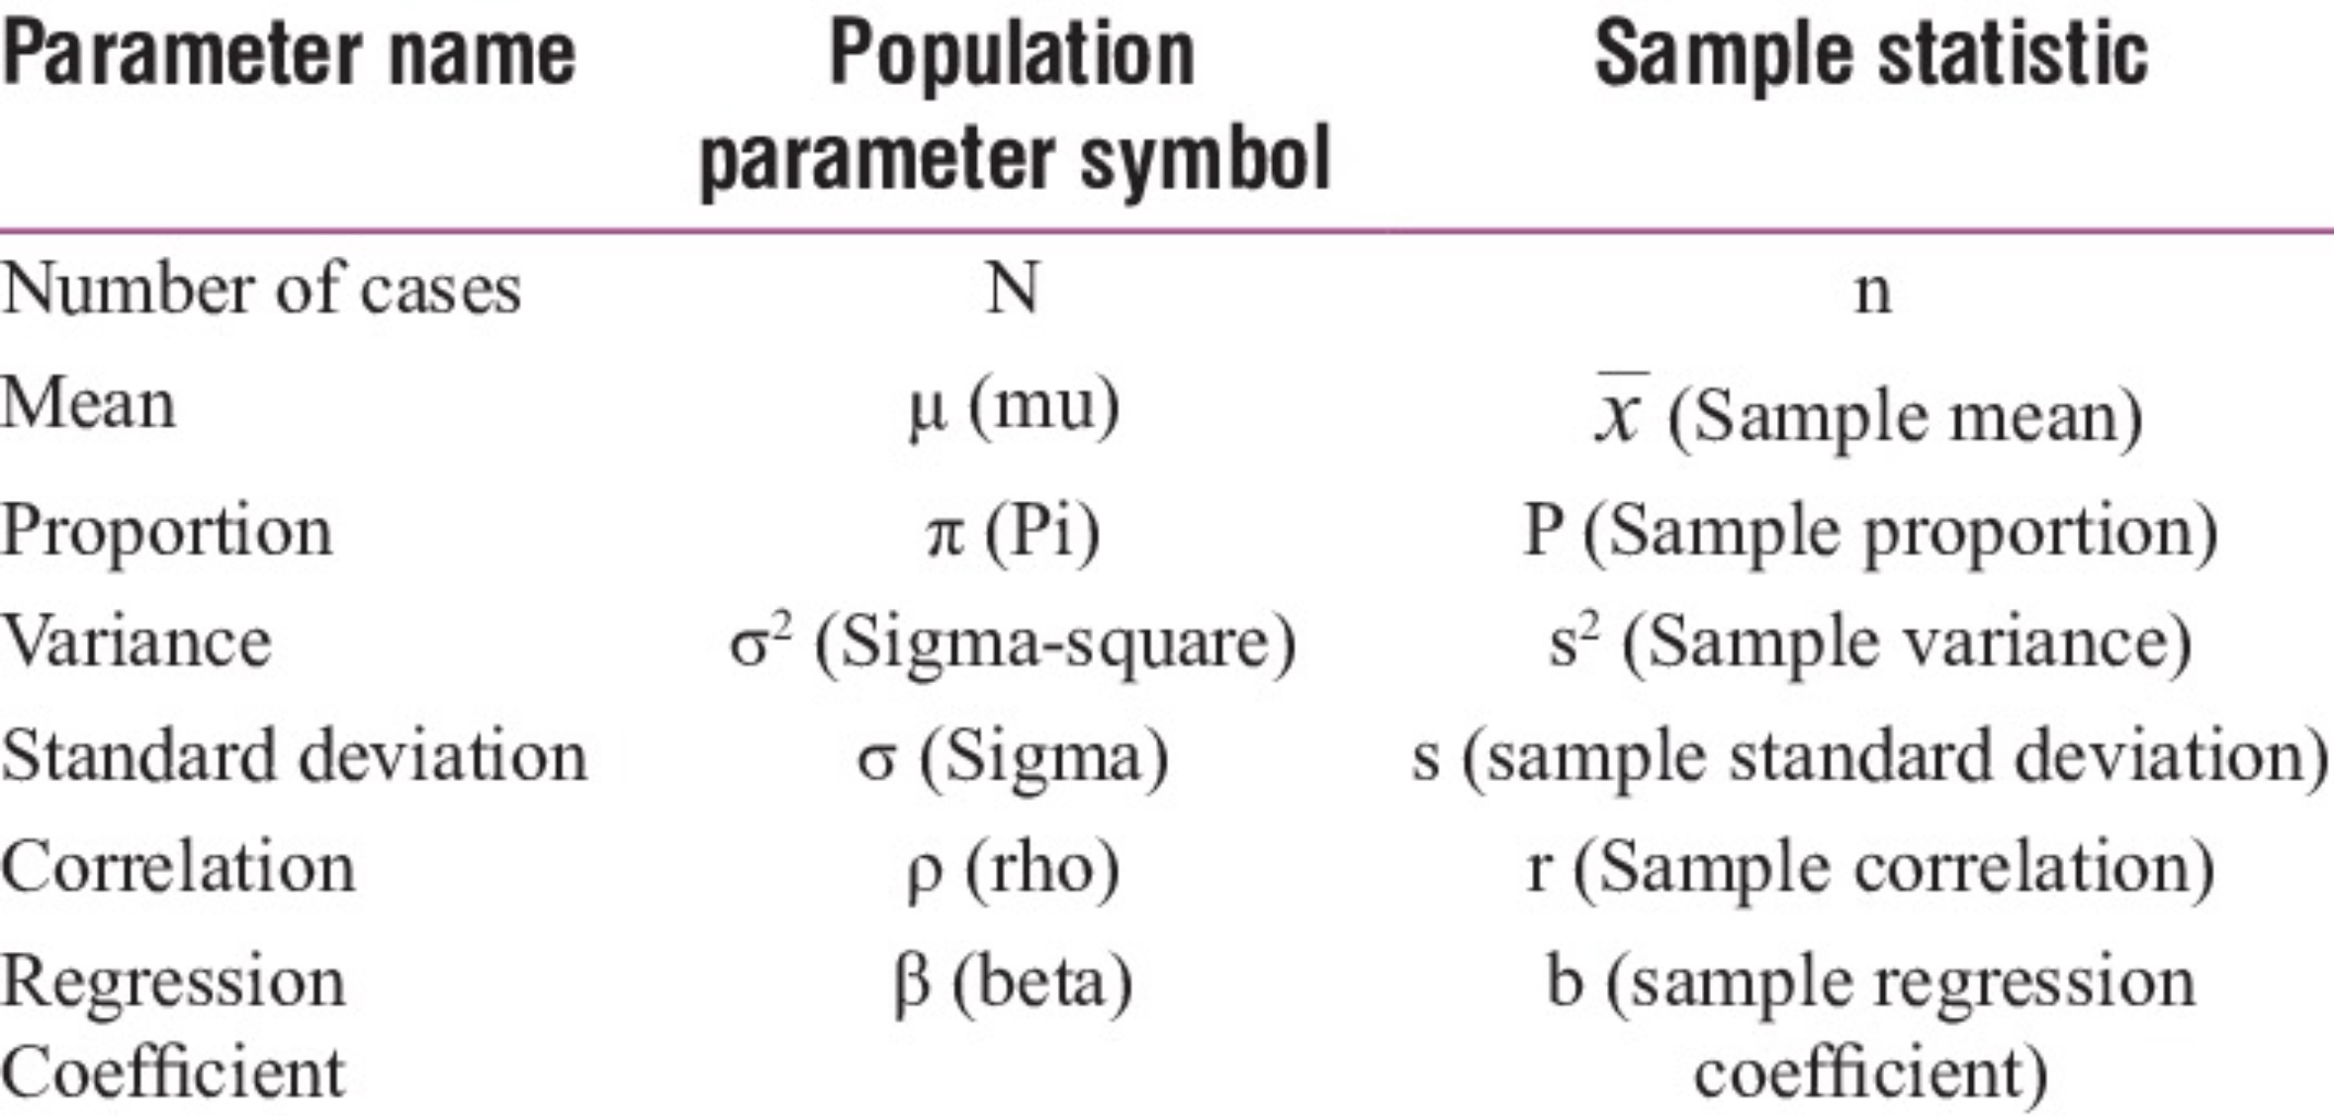
Parameters

Slide 9
What is a standard error, exactly?
If a standard deviation shows how the data spreads out from the sample mean,
Then a standard error is a standard deviation of several means. It shows how several means spread out from the average of those means.
The formula of SE is:
Standard Error = s/SQRT(n)
It is used for determining the confidence interval.

Slide 10
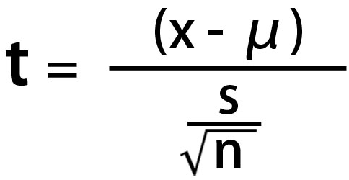
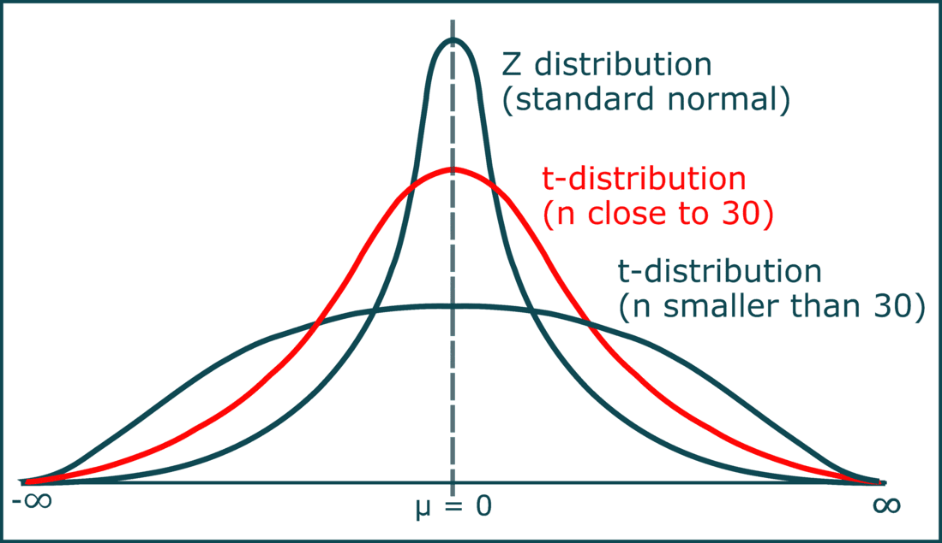
t-Distribution
t-distribution resemble a standard normal distribution with a mean of 0 and a standard deviation of 1.
It is a distribution that is normalized from any set of data samples by this formula:
The shape of the curve in t-distribution
is reflected by the sample size.

Slide 11
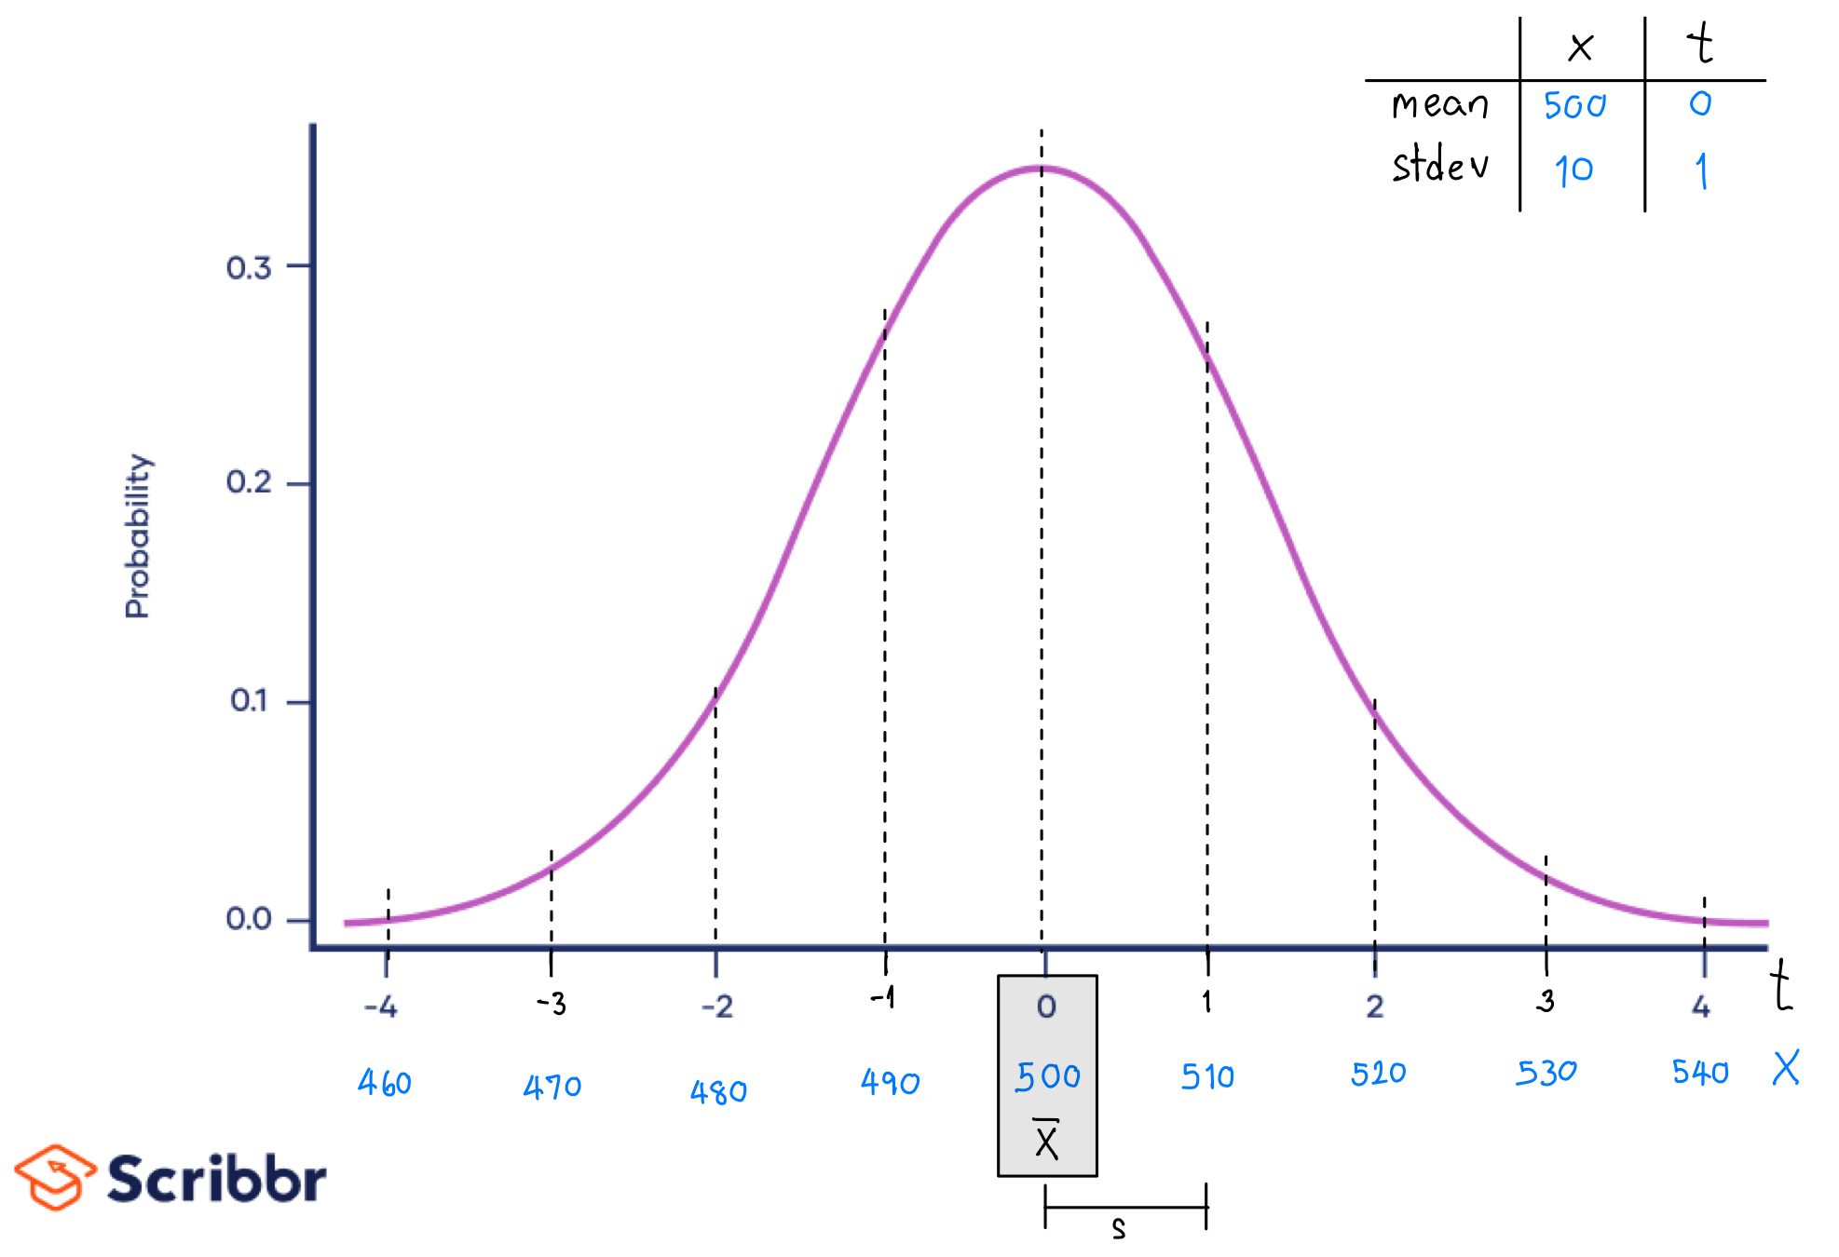
Relation between random variable X and t 🍺
Suppose our sample glasses of beer has a mean of 500ml and a stdev of 10ml.
As our mean goes up by 1 stdev (from 500 to 510), the value of t (or tSTAT) is also goes up by 1.

Slide 12
z-Distribution vs. t-Distribution
These are both distribution curves. The only difference is that we use t-distribution when we don’t know the population standard deviation(σ).
In real world data, it is almost impossible to calculate a standard deviation of the population. We usually only know the standard deviation of our sample(s).
So we use t-distribution and tSTAT for determining confidence interval and hypothesis testing instead. (Reminder: if the problem gives you the population standard deviation, you should use z instead of t.)

Slide 13
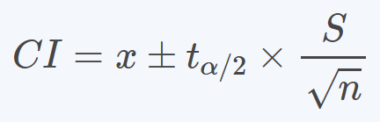
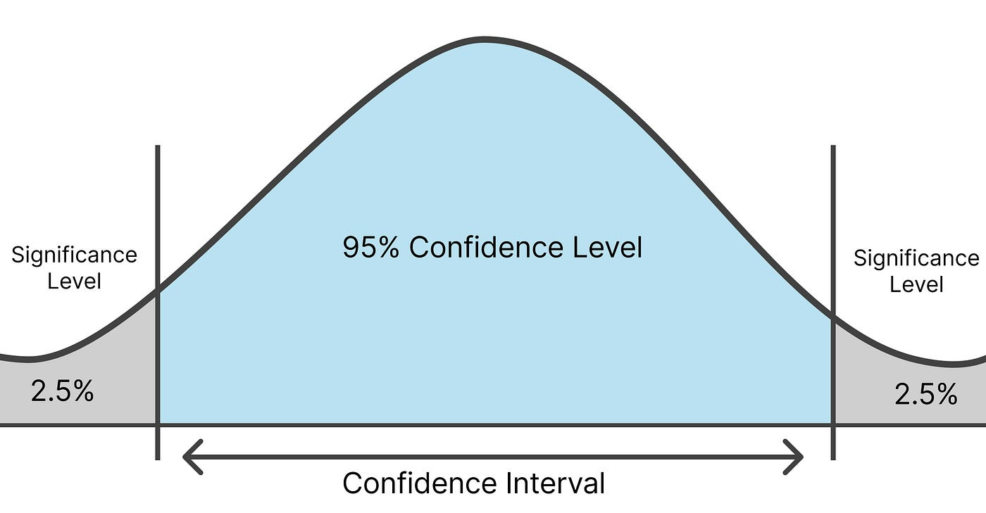
Confidence Interval (CI)
A confidence interval is the mean of our estimate (x̄) plus and minus the variation in that estimate (t times S.E. or s/SQRT(n) ).
At our confidence level (default at 95%) we are sure that the true mean will fall in this range of our confidence interval.
95% of total area under the curve
t_{α/2} = T.INV(0.975,df)

Slide 14
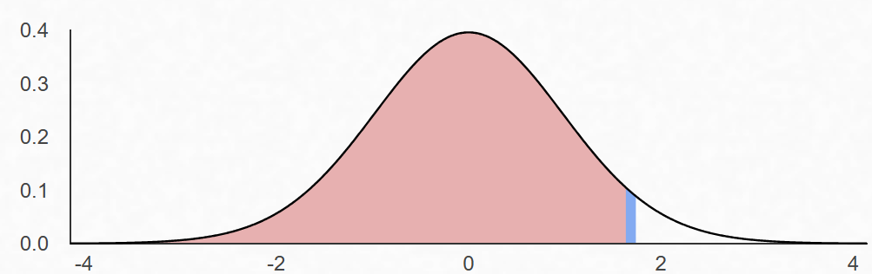
Confidence Interval (CI) 🍺
What is the 95% confidence interval of our beer volume if our beer samples have following variables?
  mean: 500ml.
  stdev: 20ml.
  sample size: 20 glasses
All variables are given except t_{α/2} , which we have to use Excel to calculate.
  Excel’s T.INV function requires 2 variables
    The whole area from the left side until it covers 95% in the middle = 2.5% + 95% = 0.975
    The degrees of freedom = n-1 = 20-1 = 19
  t_{α/2} = T.INV(0.975,19) = 2.0930
LL = 490.6397, UL = 509.3603
t_{α/2}
2.5%
95%
2.5%

Slide 15
A Customer’s Complaint! 🍺
A customer just called us. He claimed that the original beer we are selling are surely less than 500ml on average and he wants a refund or else he would sue us.
Before replying, we would need to test our samples again and see if we have REALLY done something wrong.
We are going to test if our beer volume is actually lower than 500ml by using the Hypothesis Testing.

Slide 16
Hypothesis Testing
Hypothesis testing is a statistical method used to determine if there is enough evidence in a sample data to draw conclusions about a population.
It involves formulating two competing hypotheses, the null hypothesis (H₀) and the alternative hypothesis (H_{a}).
H₀: Something you want to reject.
H_{a}: Something you are interested in.

Slide 17
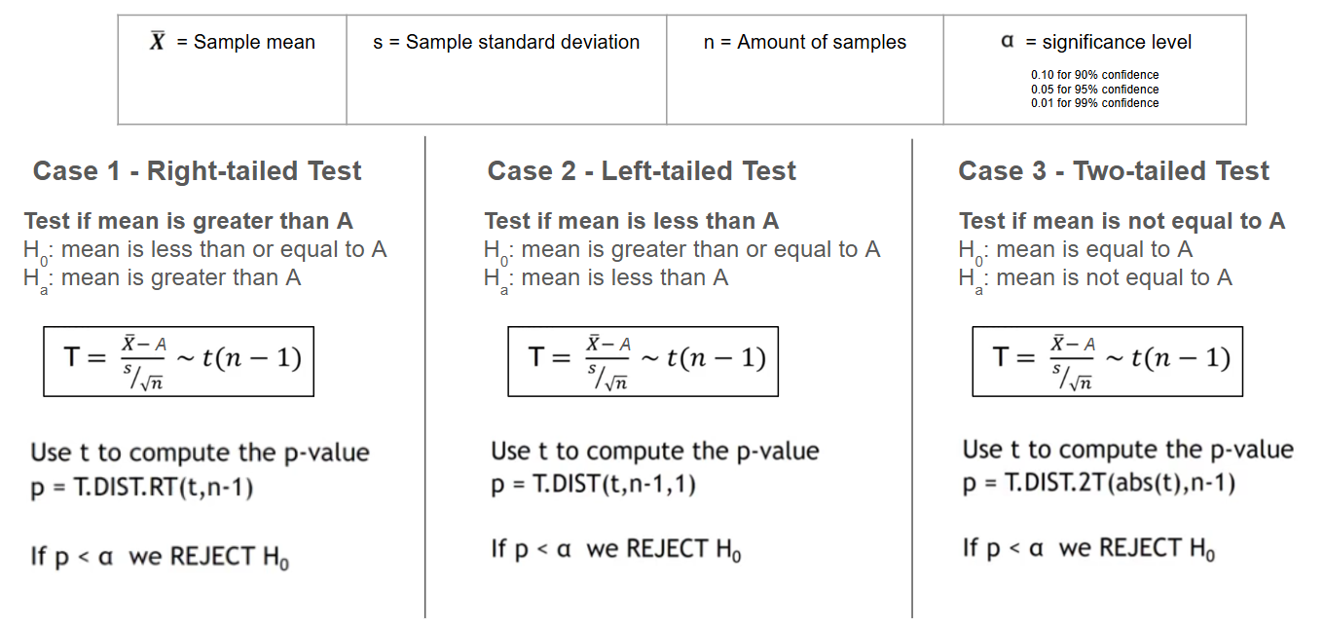
Hypothesis Testing

Slide 18
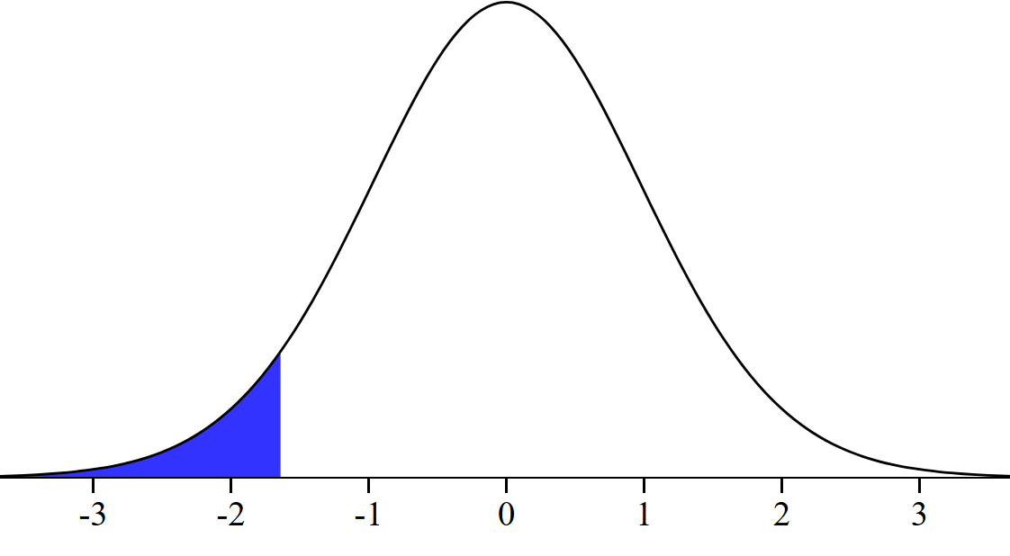
T.DIST vs. T.INV
T.DIST(t,df,TRUE) returns the percentage of the area from the far left up to the t value.
T.INV(%area from the far left, df) returns the t value on the rightmost of the blue area.
What if we want a right-tailed area?
or two-tailed area?
T.DIST(-1.7,19,TRUE) = 0.0527
T.INV(0.0527, 19) = -1.7002
-1.7
5.27%

Slide 19
Hypothesis Testing 🍺
After the call from the customer, we have examined 20 sample glasses of original beer and found that:
  The average volume is 489ml.
  The stdev is 20ml.
We are going to test if our true mean of original beer volume is actually lower than 500ml by using the Hypothesis Testing.
Let’s create the hypothesis:
  H₀: μ ≥ 500
  H_{a}: μ < 500

Slide 20
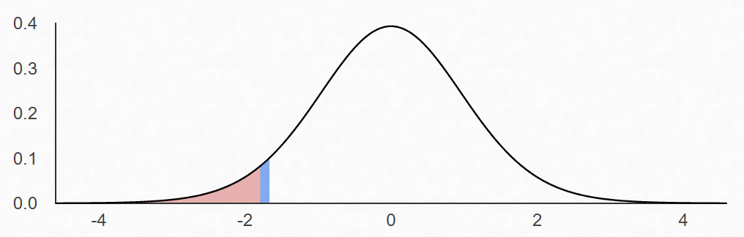
tSTAT - tCRIT Approach 🍺
x̄ = 489ml.
s = 20ml.
n = 20
H₀: μ ≥ 500.
H_{a}: μ < 500.
This approach is carried out by comparing the extremeness of value t of the x̄ (t of the statistic or tSTAT) and the value t that separates the rejection and non-rejection zone (tCRIT).
In this case, H_{a} is μ < 500, which is considered to be left-tailed testing.
This means that if our calculated tSTAT falls on the rejection region (left side of tCRIT), we will reject the null hypothesis. (assume significance level α = 0.05)
tCRIT = T.INV(0.05,19)
tCRIT
α = 5%
95%

Slide 21
tSTAT - tCRIT Approach 🍺
x̄ = 489ml.
s = 20ml.
n = 20
H₀: μ ≥ 500.
H_{a}: μ < 500.
tSTAT = (489-500) / (20/SQRT(20)) = -2.4597
tCRIT = T.INV(0.05,19) = -1.7291
Since tSTAT falls in the rejection region, we reject the null hypothesis. The average beer volume is less than 500ml.
tCRIT = -1.7291
tSTAT = -2.4597

Slide 22
The p-value Approach
x̄ = 489ml.
s = 20ml.
n = 20
H₀: μ ≥ 500.
H_{a}: μ < 500.
There is only 1 condition for the p-value approach: If p-value is less than the significance level, we reject the null hypothesis.
p-value is the area under the curve that corresponds to how extreme the tSTAT is. If the tSTAT is very extreme, the p-value will be extremely low.
However, we must be careful when using Excel’s formula.
p-value = T.DIST(-1.7,19,TRUE) = 0.0527
-1.7
5.27%

Slide 23
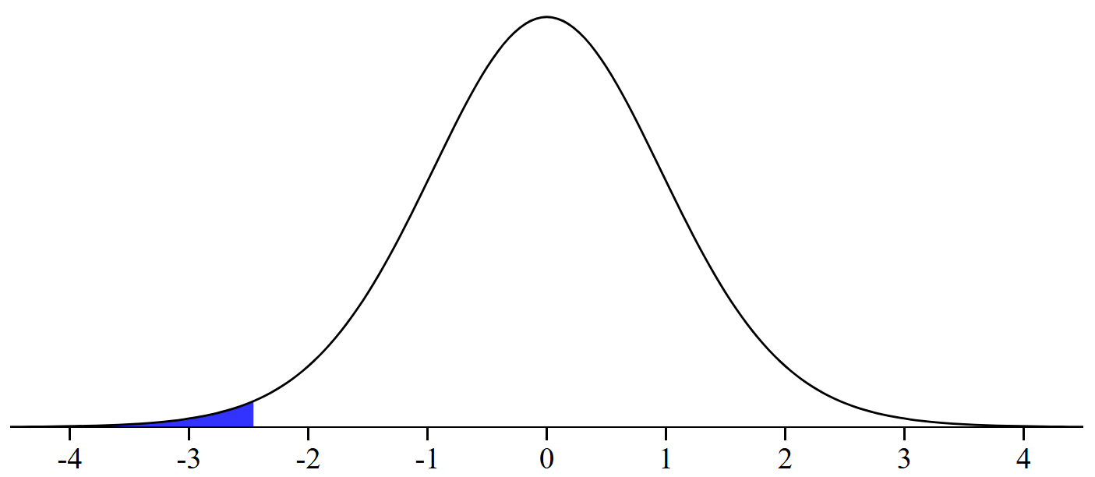
The p-value Approach 🍺
x̄ = 489ml.
s = 20ml.
n = 20
H₀: μ ≥ 500.
H_{a}: μ < 500.
From the beer inspection, we know that tSTAT is -2.4597.
p-value = T.DIST(-2.4597,19,TRUE) = 0.0118
Since p-value is less than 0.05, we reject the null hypothesis. The average original beer volume is less than 500ml.
tSTAT = -2.4597
1.18%

Slide 24
Two-Sample t-Test
The two-sample t-test is a method used to test whether the unknown population means of two groups are equal or not.
H₀: μ₁ = μ₂
H_{a}: μ₁ ≠ μ₂
We can test the hypothesis by using the Two-Sample t-Test (with equal or unequal variance) in the “Data Analytics” add-in in Excel.

Slide 25
Two-Sample t-Test 🍺
We are going to test if our original beer and our new “light beer” has the same volume.
Let μ₁ be the true average volume of original beer
Let μ₂ be the true average volume of light beer
Our hypothesis is:
  H₀: μ₁ = μ₂
  H_{a}: μ₁ ≠ μ₂
Let’s do this in the Excel

Slide 26
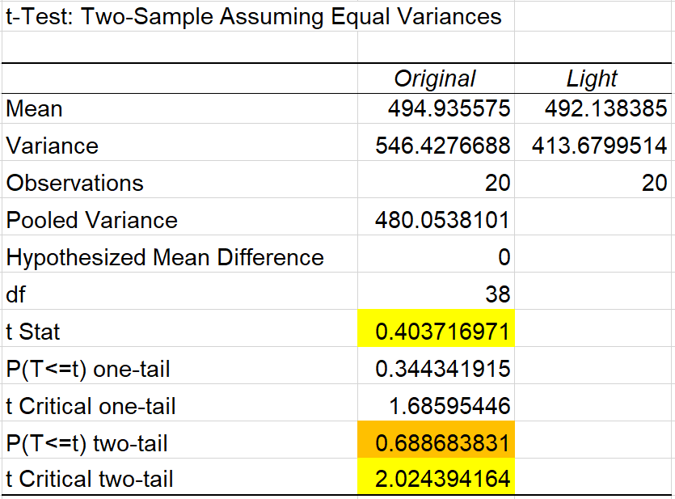
Two-Sample t-Test 🍺
tSTAT is less extreme than tCRIT.
p-value is greater than the significance level (0.05)
Therefore, we cannot reject the null hypothesis, there is no significant difference between the average volume of original and light beer.

Slide 27
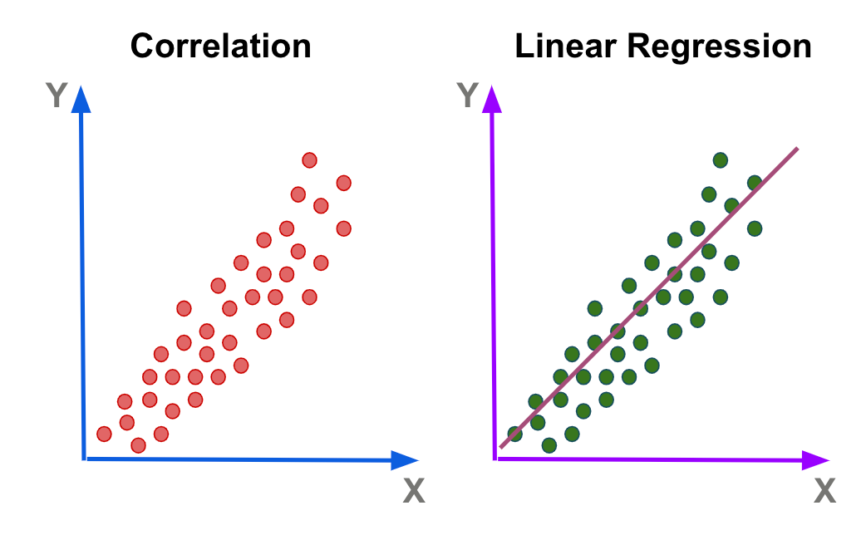
Simple Linear Regression
Marketing Cost vs Profit of 40 Companies
We use linear regression to see if there is a relationship between 2 variables.
Y = b₁X + b₀
How to determine what should be Y or X?
Y is what we wanted to predict
X is the input
b₀ is the intercept
b₁ is the slope
Profit ($)
Marketing Cost ($)

Slide 28
Solver
an add-in to find an optimal (maximum or minimum) value for the objective cell — subject to constraints, or limits, on the values of other formula cells on a worksheet.
For example, we want to find b0 and b1 value for our linear regression line using Solver.
We know that the best fitting line is the line that minimizes our Sum of Squared Error.
The Solver will random b0 and b1 until we get the possible minimum Sum of Squared Error.
However, we can use SLOPE and INTERCEPT instead.
Profit ($)
Marketing Cost ($)

Slide 29
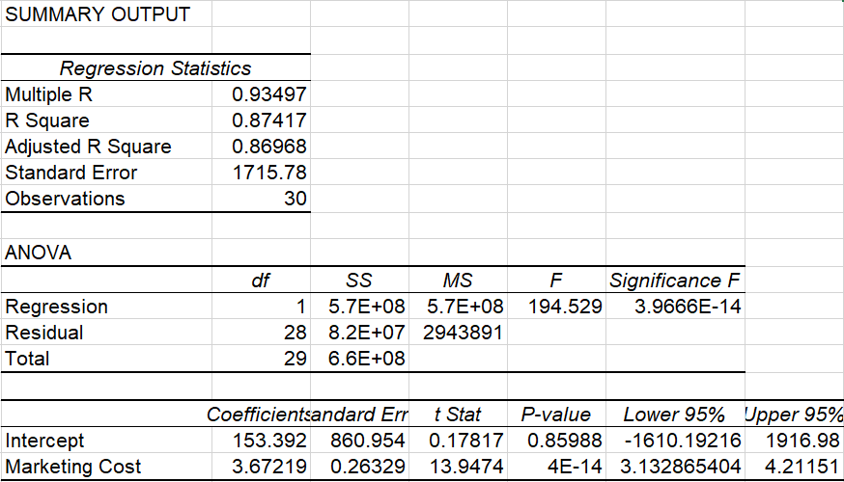
Reading the Analysis of Variance (ANOVA)
R Square shows how fit the data is to the model.
Significance F means the regression is significant.
p-value tells us if each variable is significant.

Slide 30
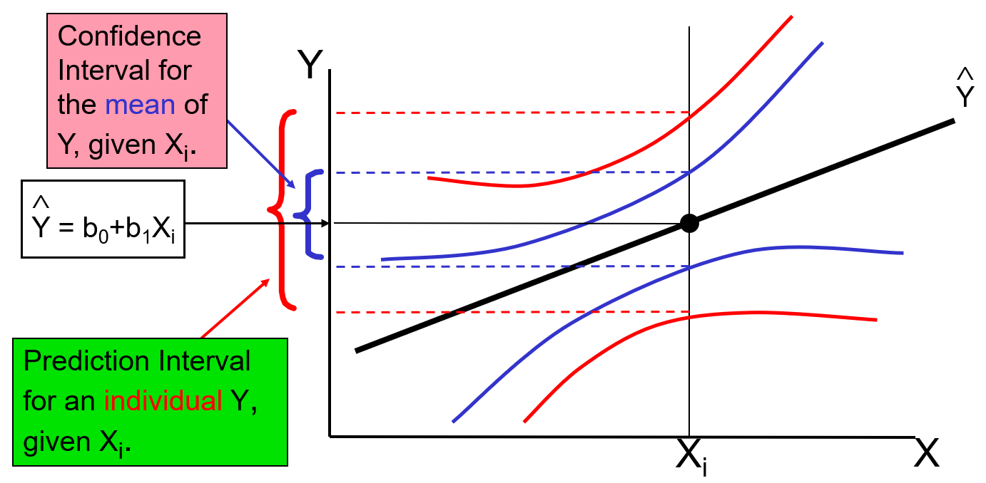
Estimating Mean Values vs Predicting Individual Values
Confidence Interval is the range where we think the true mean will fall into.
Prediction Interval is the area where we think the data will scatter around the true mean.
That’s why the prediction interval is wider than the confidence interval.

Slide 31
Multiple Linear Regression
When there are more than 2 variables, it is impossible to use simple linear regression. This is where multiple regression comes in.
For example, to predict the price of a condo, we might need these factors:
  Location
  Nearby public transports
  Room size
  Number of bedrooms
  And many more…

Slide 32
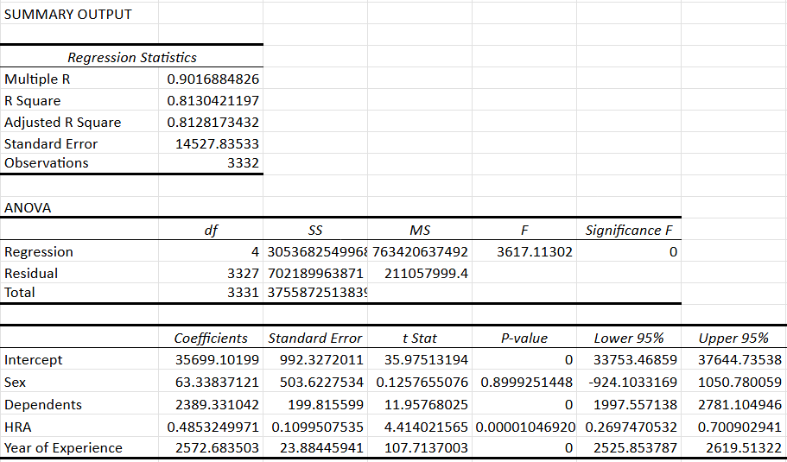
Reading the Analysis of Variance (ANOVA)
Y = 3.3384(x1)+2389.331(x2)+0.4853(x3)+2572.6835(x4)+35699.102

