Slide 1
Summation
Professor Brett A. Saraniti

Slide 2

Summation
$$\sum_{i=1}^{3}{(10i−8)}$$
$$=\left(10∙1−8\right)+\left(10∙2−8\right)+\left(10∙3−8\right)=36$$

Slide 3

Another Quick Example
$$\sum_{n=5}^{7}{2^{n}}=2^{5}+2^{6}+2^{7}=32+64+128=224$$

Slide 4
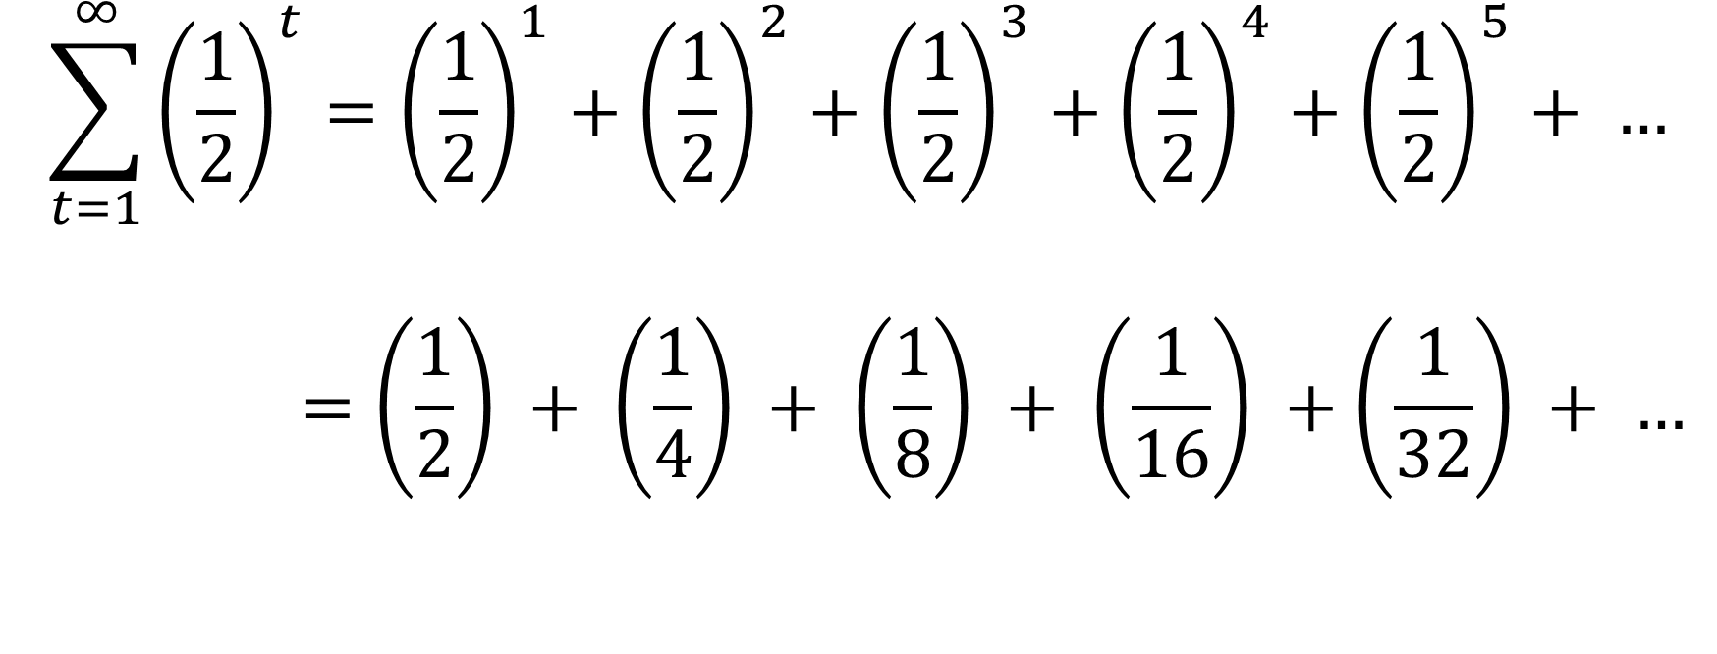
An Infinite Sum
$$\sum_{t=1}^{∞}{{\left(\frac{1}{2}\right)}^{t}={\left(\frac{1}{2}\right)}^{1}+{\left(\frac{1}{2}\right)}^{2}+{\left(\frac{1}{2}\right)}^{3}+{\left(\frac{1}{2}\right)}^{4}+{\left(\frac{1}{2}\right)}^{5}+ …}$$
$$=\left(\frac{1}{2}\right) + \left(\frac{1}{4}\right) + \left(\frac{1}{8}\right) + \left(\frac{1}{16}\right) +\left(\frac{1}{32}\right) + …$$

Slide 5

Conclusion
= $\left(\frac{1}{2}\right)+\left(\frac{1}{4}\right)+$ $\left(\frac{1}{8}\right)+\left(\frac{1}{16}\right)+\left(\frac{1}{32}\right)+ …$
$$\sum_{t=1}^{∞}{{\left(\frac{1}{2}\right)}^{t}=1}$$
0 1

Slide 6
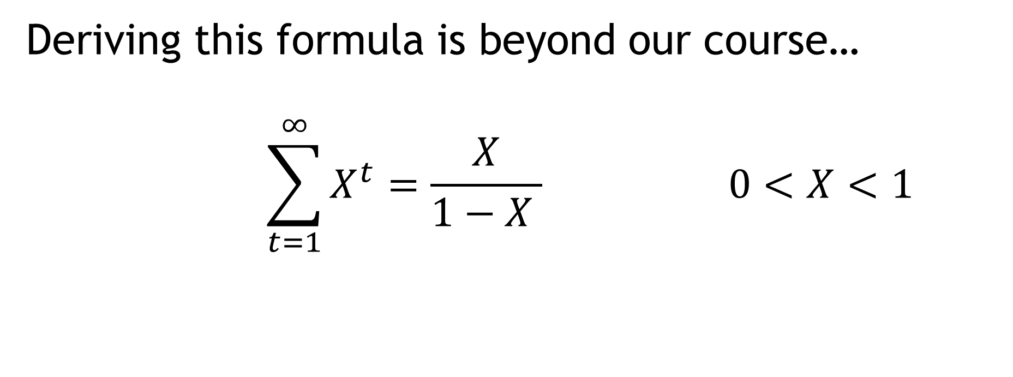
General Formula
Deriving this formula is beyond our course…
$$\sum_{t=1}^{∞}{X^{t}=\frac{X}{1−X } 0<X<1}$$

Slide 7
Takeaways
We learned/remembered some common mathematical notation
We practiced with a few short examples
We demonstrated how an infinite number of terms can sum to a finite value

