Slide 1
Conditional Probability
Professor Brett A. Saraniti

Slide 2

Types of Probabilities
The probability of an event, A → P(A)
The probability of an event, A^{c} → P(A^{c})
The probability of both event A and event B → P(A $∩$ B)
The probability of either A or B or both → P(A $∪$ B)

Slide 3
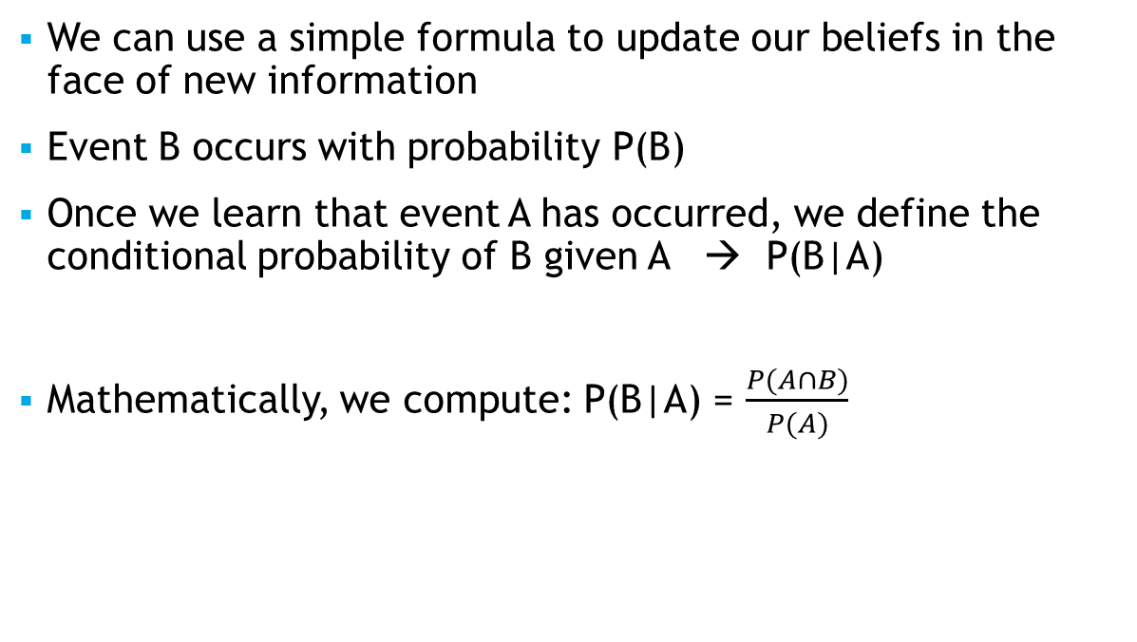
Conditional Probability
We can use a simple formula to update our beliefs in the face of new information
Event B occurs with probability P(B)
Once we learn that event A has occurred, we define the conditional probability of B given A → P(B|A)
Mathematically, we compute: P(B|A) = $\frac{P(A∩B)}{P(A)}$

Slide 4

Example -
Event B – She buys the phone
Event A – She saw the ad
P(A) = .20
P(B) = .25
P(A $∩$ B) = .10
P(B|A) = $\frac{P(A∩B)}{P(A)}=\frac{.10}{.20}=.50$

Slide 5

Independence
Sometimes one event is not informative about another.
Two events, A and B, are independent when P(A $∩$ B) = P(A) $∙$ P(B)
Notably, when this is true: P(B|A) = $\frac{P(A∩B)}{P(A)}=\frac{\text{P}\text{(}\text{A}\text{) }∙ \text{P}\text{(}\text{B}\text{) }}{\text{P}\text{(}\text{A}\text{) }}=P(B)$
When two events are NOT independent, we say they are dependent events.

Slide 6
Takeaways
We reviewed different types of probabilities and introduced conditional probability
We introduced the idea of independent and dependent events

