Slide 1
Random Variables
Professor Brett A. Saraniti

Slide 2
Random Variables
We define X to be a random variable with a certain probability distribution as shown
The possible outcomes or realizations of X are denoted by lower case x.
Note that the x’s must be numerical values
x | P(X=x)
0 | .40
1 | .40
2 | .10
3 | .10

Slide 3

Traits of Random Variables
The mean or expected value of X is a weighted average of the x’s where the weights are the probabilities.
E(X) = .40(0) + .40(1) + .10(2) + .10(3) = 0.90
Sometimes we use $μ$ or $μ_{x}$ to denote this trait
x | P(X=x)
0 | .40
1 | .40
2 | .10
3 | .10

Slide 4

Traits of Random Variables
The variance of X is a weighted average of the squared distance from the x’s to the mean.
Var(X) = .40(0-.9)² + .40(1-.9)² + .10(2-.9)² + .10(3-.9)² = 0.89
Sometimes we use $σ^{2}$ or $σ_{x}^{2}$ to denote this trait
x | P(X=x)
0 | .40
1 | .40
2 | .10
3 | .10

Slide 5
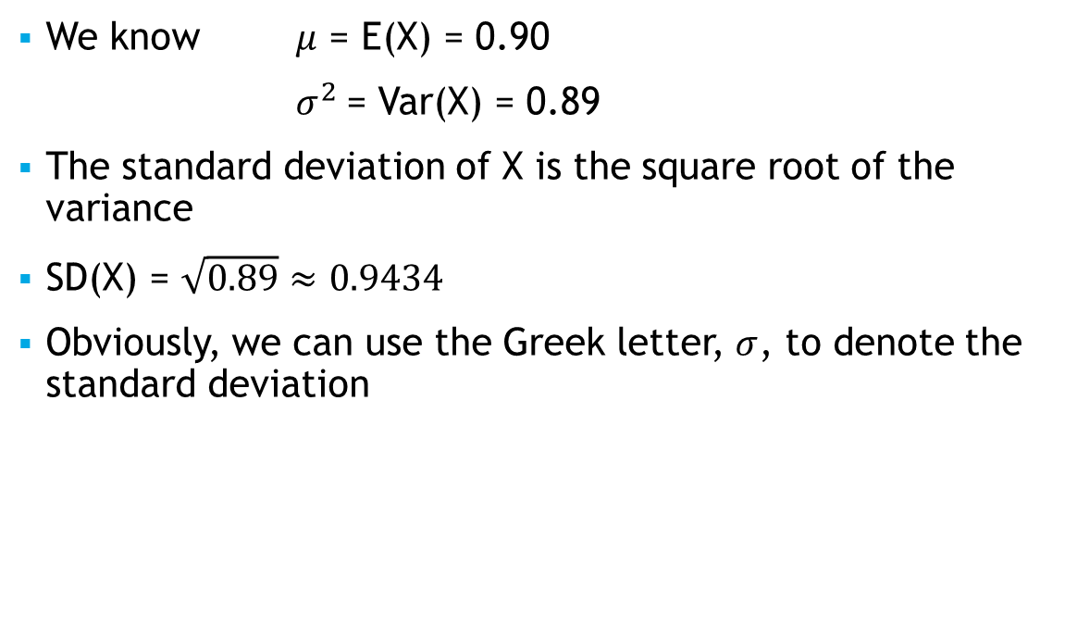
Other Traits
We know $μ$ = E(X) = 0.90
$σ^{2}$= Var(X) = 0.89
The standard deviation of X is the square root of the variance
SD(X) = $\sqrt{0.89}≈0.9434$
Obviously, we can use the Greek letter, $σ$, to denote the standard deviation

Slide 6
Multiple Random Variables
Functions of random variables are also random variables
We can derive formulas for the traits of such functions like: aX + bY
E(aX + bY) = aE(X) + bE(Y)
Var(aX + bY) = a²Var(X) + b²Var(Y) when X and Y are independent
Note: If b=0, E(aX) = aE(X) and Var(aX) = a²Var(X)

Slide 7
Takeaways
We introduced the notion of a random variable
We identified some key traits, common notation, and how to compute them
We showed how to compute the traits of linear combinations of random variables

