Slide 1
Correlation
Professor Brett A. Saraniti

Slide 2
Multiple Random Variables
 |  | Y
 |  | 10 | 14
X | 0 | .20 | .05
 | 20 | .55 | .20
E(X) = .25(0) + .75(20) = 15
E(Y) = .75(10) + .25(14) = 11
Var(X) = .25(0-15)² + .75(20-15)² = 75
Var(Y) = .75(10-11)² +.25(14-11)² = 3

Slide 3
Multiple Random Variables
 |  | Y
 |  | 10 | 14
X | 0 | .20 | .05
 | 20 | .55 | .20
E(X) = 15 and E(Y) = 11
Var(X) = 75 and Var(Y) = 3
Cov(X,Y) = .20(0-15)(10-11) +
.05(0-15)(14-11) +
.55(20-15)(10-11) +
.20(20-15)(14-11) = 1.0

Slide 4
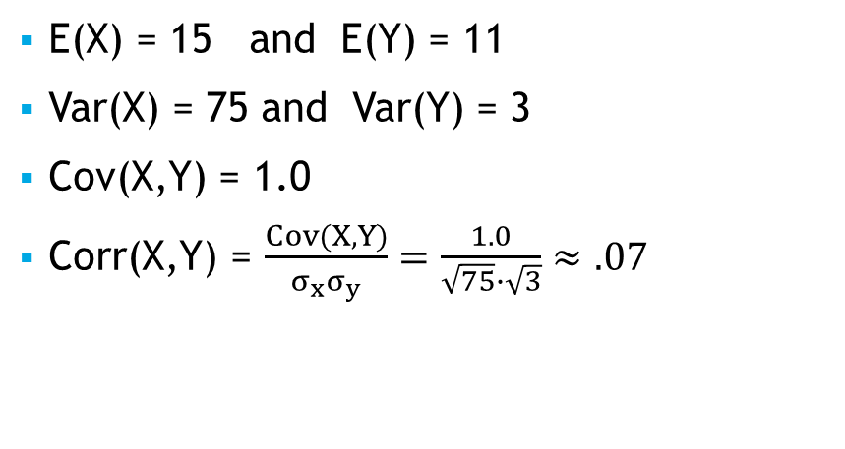
Multiple Random Variables
 |  | Y
 |  | 10 | 14
X | 0 | .20 | .05
 | 20 | .55 | .20
E(X) = 15 and E(Y) = 11
Var(X) = 75 and Var(Y) = 3
Cov(X,Y) = 1.0
Corr(X,Y) = $\frac{Cov(X,Y)}{σ_{x}σ_{y}}=\frac{1.0}{\sqrt{75}∙\sqrt{3}}≈.07$

Slide 5

Correlation
Corr(X,Y) is sometimes denoted by $ρ_{xy}$
$ρ_{xy}=\frac{σ_{xy}}{σ_{x}σ_{y}}$
We can show that: $−1≤ρ_{xy}≤ 1$ for any X and Y.

Slide 6
Traits – Independent or NOT
Var(X+Y) = Var(X) + Var(Y) + 2Cov(X,Y)
Var(aX+bY) = a²Var(X) + b²Var(Y) + 2abCov(X,Y)

Slide 7
Takeaways
We introduced the notions of a joint distributions, covariance, and correlation
We showed how to compute covariance and correlation from a joint distribution
We noted that correlation is bounded in the range [-1, +1]
We extended our variance formula from earlier to the more general case

