Slide 1
Normal Random Variables
Professor Brett A. Saraniti

Slide 2
Cumulative Distribution
The P(X ≤ x) is called the cumulative probability of X.
We can use this for any sort of probability distribution, but they really make sense for “continuous” random variables where X can take on an infinite number of possible values.

Slide 3

The Normal Distribution
The “shape” of a normal random variable X
A Normal Random Variable is completely described by its mean and standard deviation. Those two traits tell us everything we need to know!!
μ

Slide 4
Cumulative Probability
Lets say for example that X has a normal distribution with μ = 5 and σ = 3.6
P(X ≤ 2) = NORM.DIST(2, 5, 3.6,1)
2
5
The NORM.DIST function in Excel requires 4 inputs [x, μ, σ, Cumulative?]
If you type 1 for the last input, you get the cumulative prob. If you type 0, you get the height of the curve. Hint: Always type 1 !!

Slide 5
Shifting and Scaling
Consider X ~ Normal (µ,σ)
Adding or subtracting a constant (shifting) doesn’t affect the Normality
  X + b ~ Normal (µ + b,σ)
Multiplying/Dividing by a constant (scaling) doesn’t either
  aX ~ Normal (aµ,aσ )
Combining:
  Y = aX+b ~ Normal (aµ+b,aσ )

Slide 6
One Important Shift/Scale
We often like to “convert” or “translate” everything into one particular version of the normal distribution.
We call this the Standard Normal and denote it as “Z”
Z ~ Normal (0,1)
Notably, Z = ~ Normal (0,1)

Slide 7
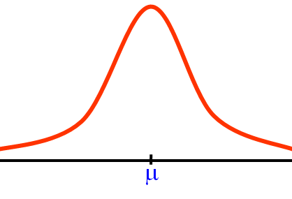

A Few Quick Shortcuts
Z ~ Normal (0, 1)
We know:
P[$−1≤Z≤1] ≈\frac{2}{3}$
P[$−2≤Z≤2] ≈\frac{19}{20}$
P[$−3≤Z≤3] ≈\frac{399}{400}$
0

Slide 8
Excel Commands: Standard Normal
Prob(Z ≤ 0.45) = ?
Prob(Z ≤ z ) = .20. What is “z” ?
Command
Output

Slide 9
Excel Commands: X~Normal(40,8)
Prob(X ≤ 45) = ?
Prob(X ≤ x ) = .20. What is “x” ?
Command
Output

Slide 10
Takeaways
We introduced the ideas of a normal random variable and the standard normal random variable
We showed how to use Excel to analyze random variables with these shapes

