Slide 1
Central Limit Theorem
Professor Brett A. Saraniti

Slide 2
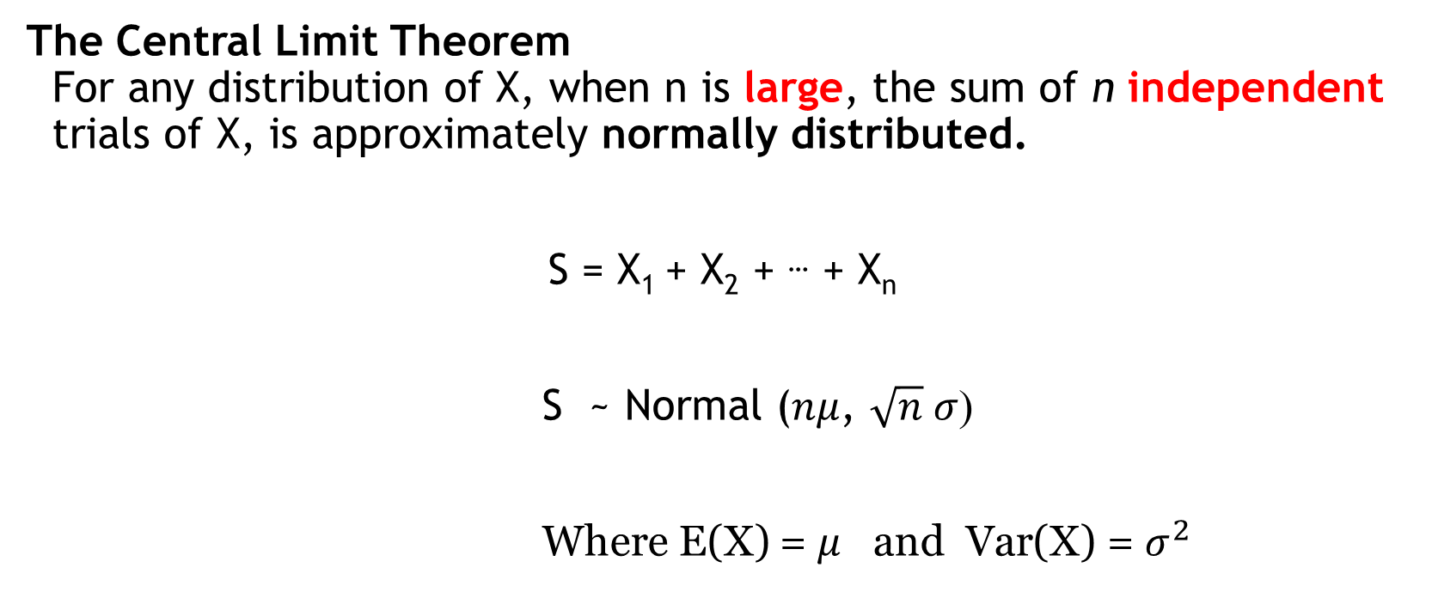
A Big Idea
The Central Limit Theorem
For any distribution of X, when n is large, the sum of n independent trials of X, is approximately normally distributed.
S = X₁ + X₂ + … + X_{n}
S ~ Normal ($nμ$, $\sqrt{n} σ$)
Where E(X) = $μ$ and Var(X) = $σ^{2}$
Notes:
de Moivre, Laplace earliest discoverers
Galton

Slide 3
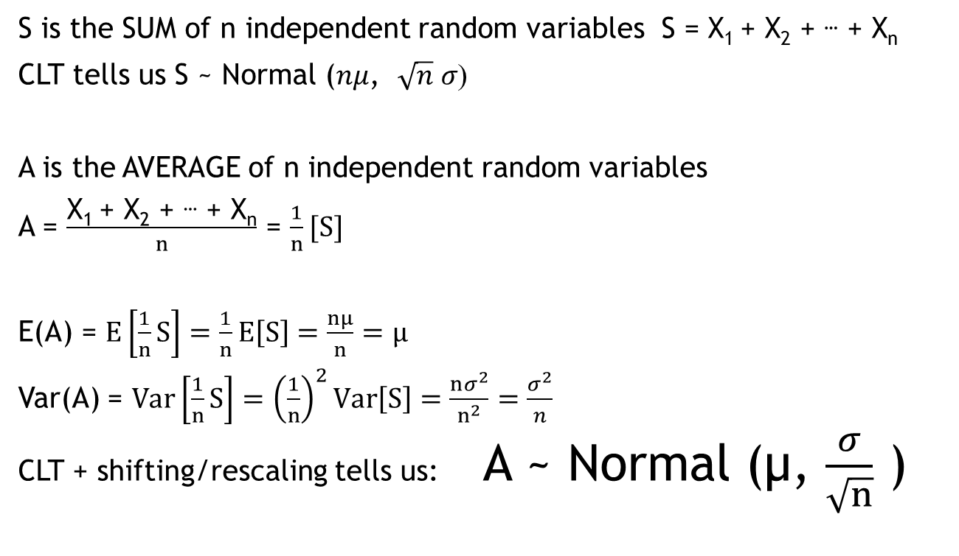
SUM into AVERAGE
S is the SUM of n independent random variables S = X₁ + X₂ + … + X_{n}
CLT tells us S ~ Normal ($nμ$, $\sqrt{n} σ$)
A is the AVERAGE of n independent random variables
A = $\frac{\text{X}\text{1 }\text{+ }\text{X}\text{2}\text{ + }\text{…}\text{ + }\text{Xn}}{n}$ = $\frac{1}{n}[S]$
E(A) = $E\left[\frac{1}{n}S\right]=\frac{1}{n}E\left[S\right]=\frac{nμ}{n}=μ$
Var(A) = ${Var\left[\frac{1}{n}S\right]=\left(\frac{1}{n}\right)}^{2}Var\left[S\right]=\frac{nσ^{2}}{n^{2}}=\frac{σ^{2}}{n}$
CLT + shifting/rescaling tells us: A ~ Normal (µ, $\frac{σ}{\sqrt{n}}$ )

Slide 4
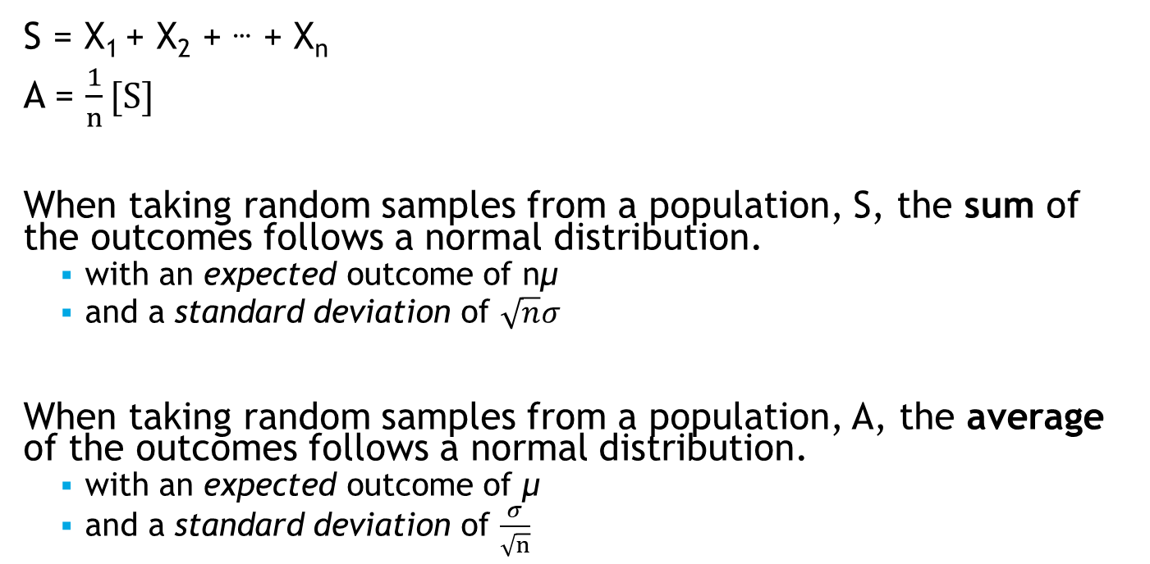
Summary
S = X₁ + X₂ + … + X_{n}
A = $\frac{1}{n}[S]$
When taking random samples from a population, S, the sum of the outcomes follows a normal distribution.
  with an expected outcome of nμ
  and a standard deviation of $\sqrt{n}σ$
When taking random samples from a population, A, the average of the outcomes follows a normal distribution.
  with an expected outcome of μ
  and a standard deviation of $\frac{σ}{\sqrt{n}}$

Slide 5
Examples
A firm needs to set aside funds to satisfy potential warranty claims for one product. The firm wants to minimize these funds, but also have a reasonable chance that the funds will be sufficient to cover all claims.
A firm wants to keep its inventory levels down, but also limit the odds it runs out of stock in the next month.
Quality control: A pharmaceutical company finds a pallet of drug vials to be underweight. How likely is this under normal conditions? … when their vial injector is partially clogged?

Slide 6
Each example has these elements…
A large number of individual trials;
  Customer purchases, warranty claims, vial weights.
Repetition: The same uncertainty about each of the individual trials;
  Customers indistinguishable from each other, failure rates have the same distribution.
Summing: we only really care about the aggregate total outcome of these individual trials.
  Total of demand, warranty claims, pallet weight.

Slide 7
Takeaways
The Central Limit Theorem describes the probability distribution for the sum or average of a large number of independent trials which follow the same pattern of “randomness”
The traits are easily computed using previous lessons.
The novelty here is the shape of the distribution: It is always NORMAL!!

