Slide 1
Sampling Distributions
Professor Brett A. Saraniti

Slide 2
Sampling
We often want to know traits regarding a population
  The mean income level of tourists in Phuket
  The mean purchase intent of visitors to our website
  The mean defect rates at our factory
  The mean age of customers at our shop in Siam Square
It is often very costly or even impossible to directly measure these traits
Generally, we try to obtain a sample from the population and use the traits of that sample to infer facts about the population of interest.

Slide 3

Parameters
  Denote the population mean and standard deviation as μ and $σ$.
  We can estimate the populations traits with data from our sample:
    Denote the sample mean and sample standard deviation as $\overline{x}$ and s.
    We first ask: To what extent does $\overline{x}$ give us an accurate estimate of μ.

Slide 4

Cental Limit Theorem
$\overline{X}$ = $\frac{\text{X}\text{1 }\text{+ }\text{X}\text{2}\text{ + … + }\text{Xn} }{n}$
What can we say about the distribution of “X-Bar” ?
$\overline{X}$ ~ Normal (µ, $\frac{σ}{\sqrt{n}}$ ) because it is the average of a large number of repeated independent trials

Slide 5

A Standard Normal Distribution
The Central Limit Theorem and shifting/rescaling implies that:
$$Z= \frac{\overline{X}−μ}{σ/{\sqrt{n}}}\sim Normal(0,1)$$

Slide 6
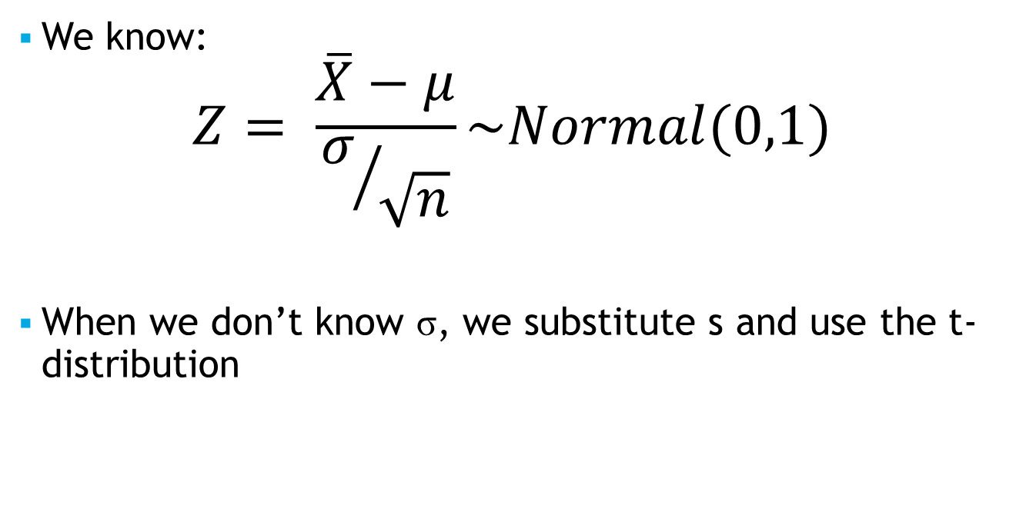
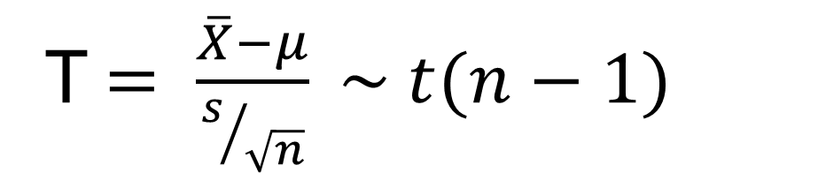
The t-distribution
We know:
$$Z= \frac{\overline{X}−μ}{σ/{\sqrt{n}}}\sim Normal(0,1)$$
When we don’t know σ, we substitute s and use the t-distribution
T$= \frac{\overline{X}−μ}{s/{\sqrt{n}}} \sim t(n−1)$

Slide 7
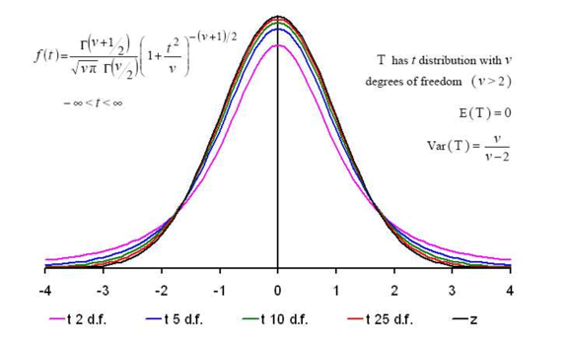
Degrees of Freedom
The degrees of freedom represent the extent to which our t distribution approaches a standard normal or z distribution.
As t gets larger, the two distributions converge

Slide 8
Takeaways
We learned about sampling and sampling distributions.
We learned that the sample mean can be used to estimate the population mean AND that we can specify its accuracy.
Next time we’ll put these ideas to work!

