Slide 1
Confidence Intervals
Professor Brett A. Saraniti

Slide 2

Fact #1
$$Z= \frac{\overline{X}−μ}{σ/{\sqrt{n}}}\sim Normal(0,1)$$

Slide 3
Fact #2
P(Z ≤ z) = .025. What is z?
=NORM.S.INV(.025) in Excel
-1.95996 or -1.96
P(Z ≤ z) = .975. What is z?
=NORM.S.INV(.975) in Excel
1.95996 or 1.96
-1.96
1.96
  $$P\left(−1.96≤Z≤1.96\right)=0.9500$$

Slide 4
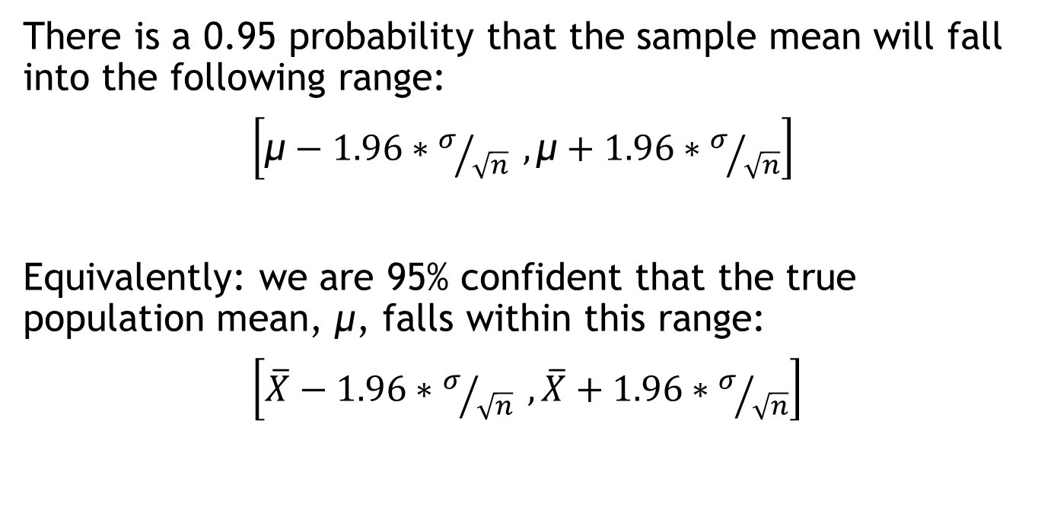
Fact #3
There is a 0.95 probability that the sample mean will fall into the following range:
$\left[\text{μ}−1.96∗σ/{\sqrt{n}} , \text{μ}+1.96∗σ/{\sqrt{n}}\right]$
Equivalently: we are 95% confident that the true population mean, μ, falls within this range:
$\left[\overline{X}−1.96∗σ/{\sqrt{n}} ,\overline{X}+1.96∗σ/{\sqrt{n}}\right]$

Slide 5

Fact #4
We will never KNOW the standard deviation, $σ$!
Luckily, we can approximate $σ$ using s.
BUT now we can’t use “1.96” anymore.
We’ll need to use a t-distribution.

Slide 6

Operationalizing These Facts
To construct a 95% confidence interval using DATA, we use Excel to compute the following values – $\overline{X}$, s, and t
To compute $\overline{X},$ for data in column A - =AVERAGE(A:A)
To compute s, for the same data - =STDEV.S(A:A)
To compute t, for n data points - =T.INV(.975,n-1)

Slide 7
The Formula
Sample mean
Sample size
Something a little bigger than 1.96 for 95% Confidence
Sample standard deviation

Slide 8

Takeaways
We learned how to construct a 95% confidence interval from raw data
This interval is a range that usually straddles the unknown population mean, $μ.$

