Slide 1
Hypothesis Tests
Professor Brett A. Saraniti

Slide 2
Big Idea
We can use the process of hypothesis testing to make statistical inferences
The process works in following way →

Slide 3
Statistical Proof
I would like to prove to you that the real mean is at least 5000.
We set up a pair of hypotheses called the null and alternative:
H₀: μ ≤ 5000
H_{a}: μ > 5000
Notice that the fact we are trying to prove is given as the alternative hypothesis.

Slide 4
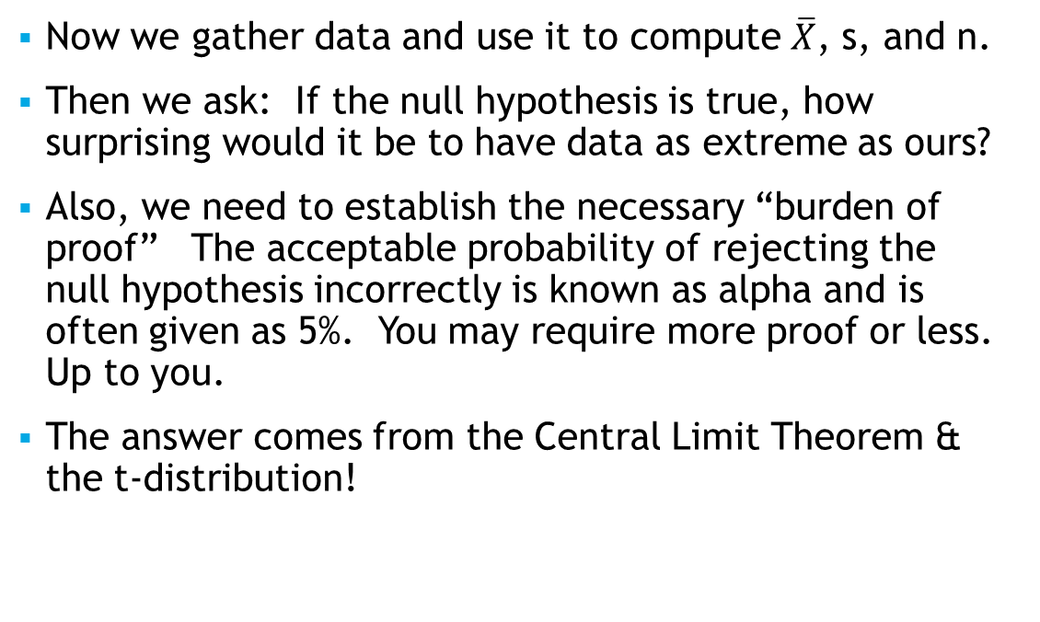
Next…
Now we gather data and use it to compute $\overline{X}$, s, and n.
Then we ask: If the null hypothesis is true, how surprising would it be to have data as extreme as ours?
Also, we need to establish the necessary “burden of proof” The acceptable probability of rejecting the null hypothesis incorrectly is known as alpha and is often given as 5%. You may require more proof or less. Up to you.
The answer comes from the Central Limit Theorem & the t-distribution!

Slide 5
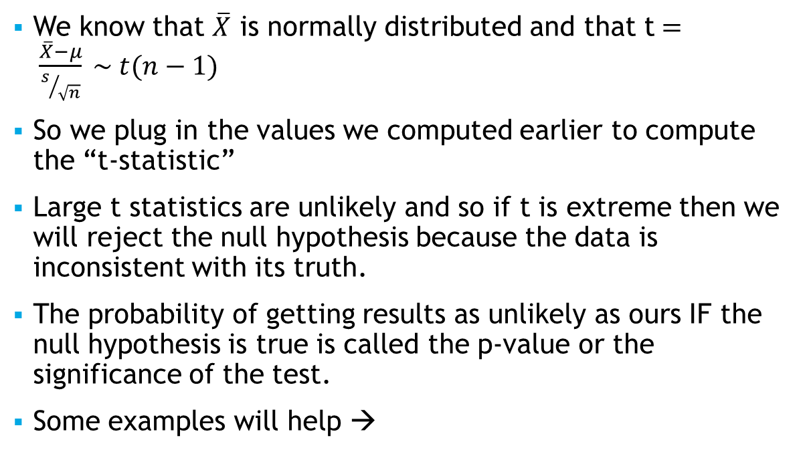
Finally…
We know that $\overline{X}$ is normally distributed and that t$= \frac{\overline{X}−μ}{s/{\sqrt{n}}} \sim t(n−1)$
So we plug in the values we computed earlier to compute the “t-statistic”
Large t statistics are unlikely and so if t is extreme then we will reject the null hypothesis because the data is inconsistent with its truth.
The probability of getting results as unlikely as ours IF the null hypothesis is true is called the p-value or the significance of the test.
Some examples will help →

Slide 6
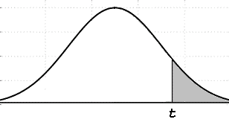
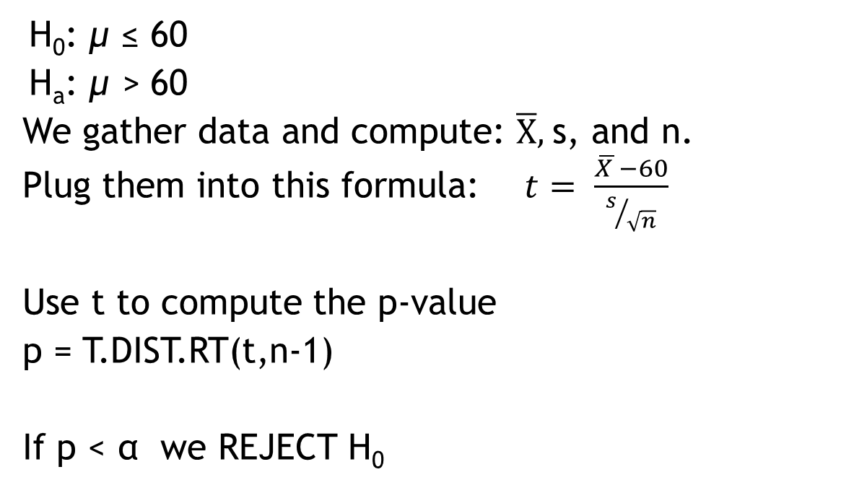
Hypothesis Tests: 3 Styles: #1 Ho ≤
H₀: μ ≤ 60
H_{a}: μ > 60
We gather data and compute: $\overline{X},$s, and n.
Plug them into this formula: $t= \frac{\overline{X }−60}{s/{\sqrt{n}}}$
Use t to compute the p-value
p = T.DIST.RT(t,n-1)
If p < α we REJECT H₀

Slide 7
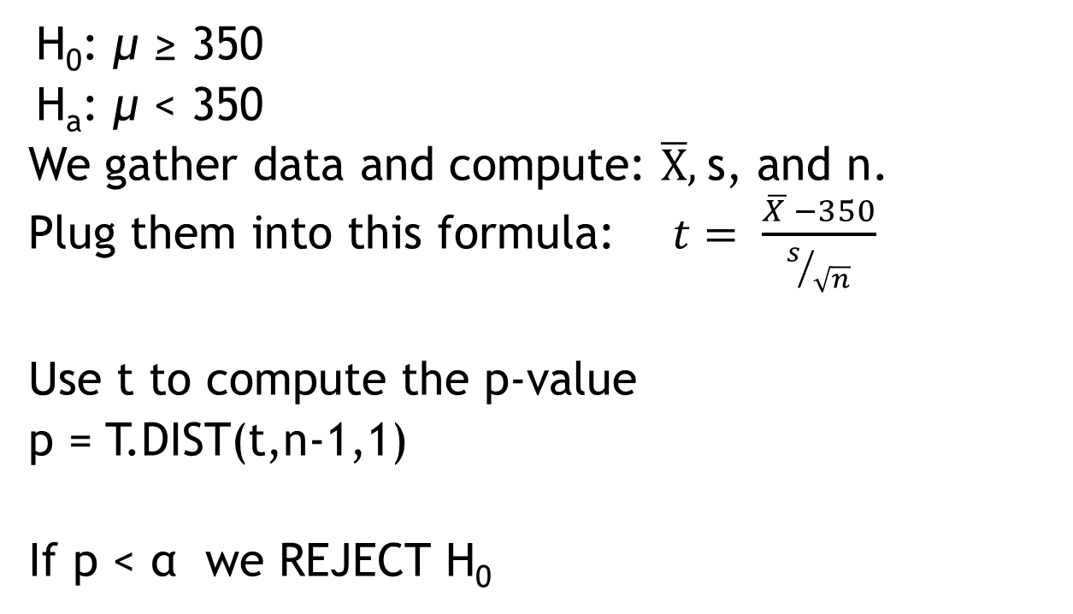
Hypothesis Tests: #2 Ho ≥
H₀: μ ≥ 350
H_{a}: μ < 350
We gather data and compute: $\overline{X},$s, and n.
Plug them into this formula: $t= \frac{\overline{X }−350}{s/{\sqrt{n}}}$
Use t to compute the p-value
p = T.DIST(t,n-1,1)
If p < α we REJECT H₀

Slide 8

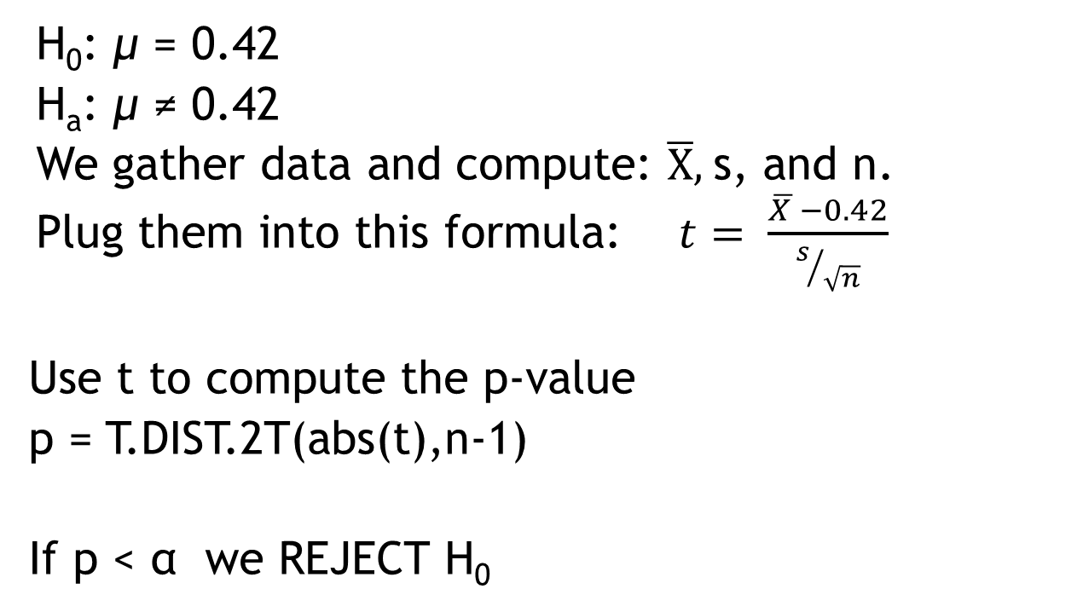
Hypothesis Tests: #3 Ho =
H₀: μ = 0.42
H_{a}: μ ≠ 0.42
We gather data and compute: $\overline{X},$s, and n.
Plug them into this formula: $t= \frac{\overline{X }−0.42}{s/{\sqrt{n}}}$
Use t to compute the p-value
p = T.DIST.2T(abs(t),n-1)
If p < α we REJECT H₀

Slide 9
Takeaways
We learned how to set up and conduct hypothesis tests
This process is common, important, and also confusing. We’ll practice it a lot moving forward to make sure it makes sense.

