Slide 1
Exponents
Professor Brett A. Saraniti

Slide 2
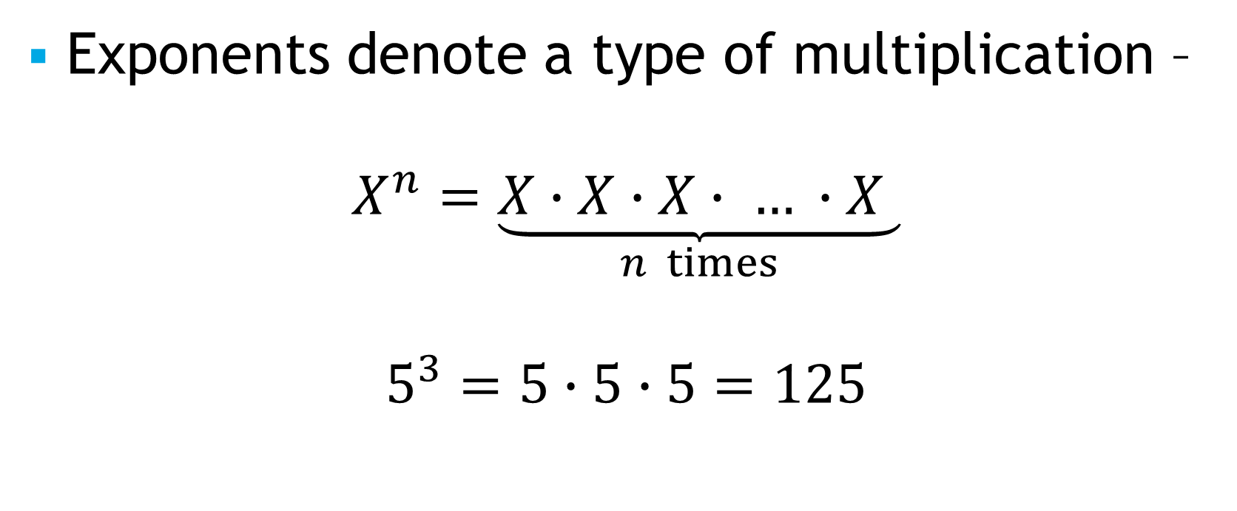
Exponents
Exponents denote a type of multiplication –
$$X^{n}=\underset{n times}{\underbrace{X∙X∙X∙ … ∙X }}$$
$$5^{3}=5∙5∙5=125$$

Slide 3
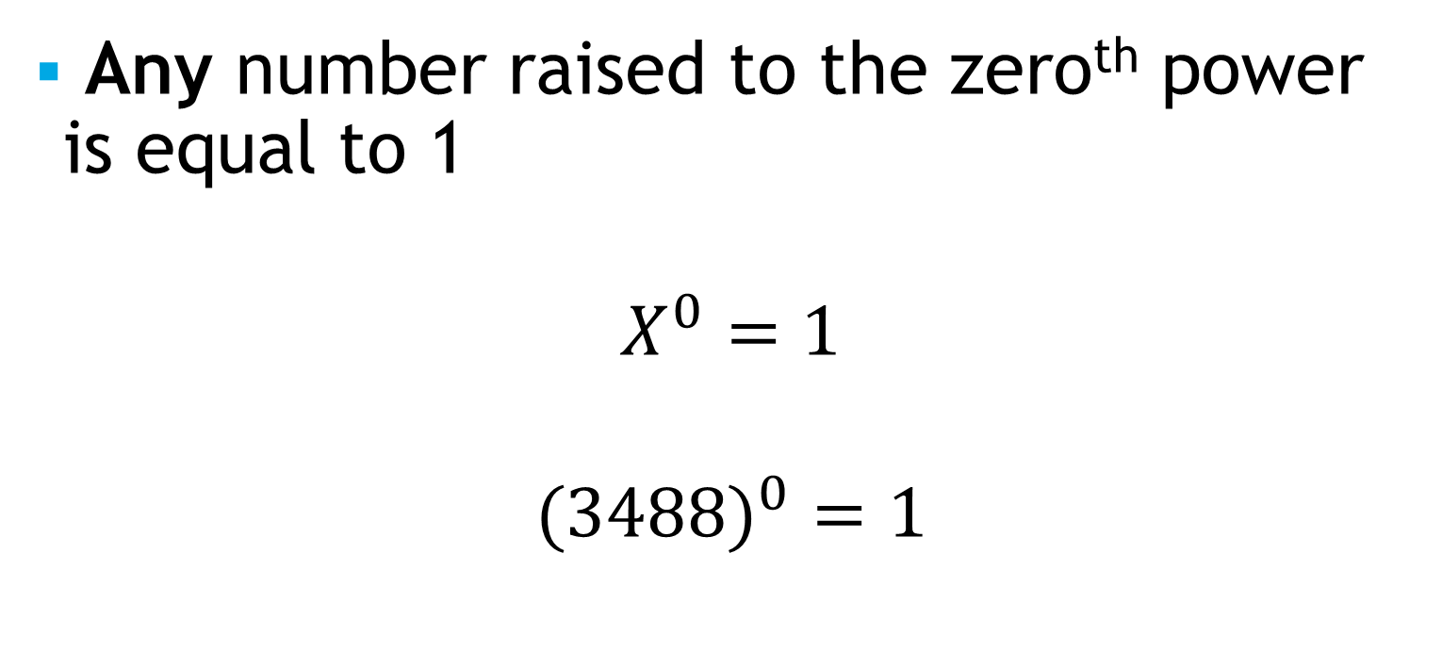
Exponents – Special Cases
Any number raised to the zero^{th} power is equal to 1
$$X^{0}=1$$
$$(3{488)}^{0}=1$$

Slide 4

Exponents – Special Cases
Any number raised to the first power is equal to itself
$$X^{1}=X$$
$${(890)}^{1}=890$$

Slide 5
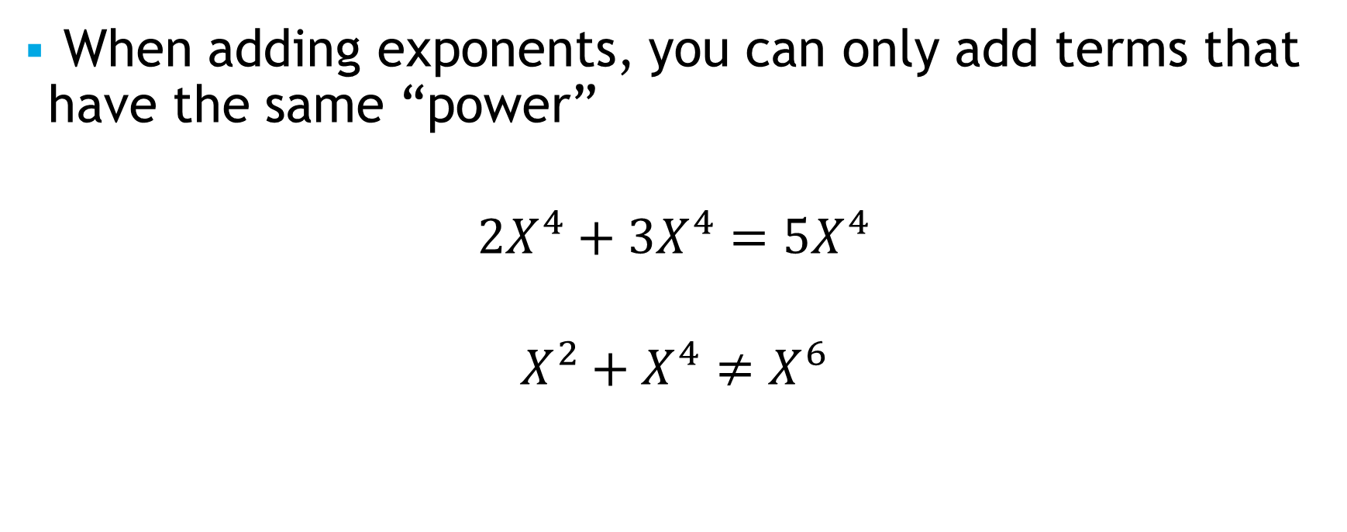
Adding Exponents
When adding exponents, you can only add terms that have the same “power”
$${2X}^{4}+{3X}^{4}={5X}^{4}$$
$$X^{2}+X^{4}≠X^{6}$$

Slide 6
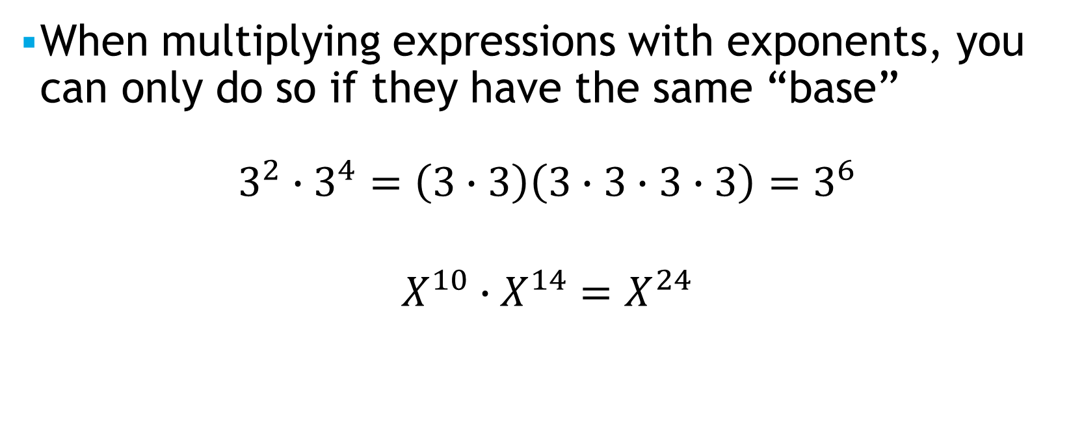
Multiplying Exponents
When multiplying expressions with exponents, you can only do so if they have the same “base”
$$3^{2}∙3^{4}={\left(3∙3\right)\left(3∙3∙3∙3\right)=3}^{6}$$
$$X^{10}∙X^{14}=X^{24}$$

Slide 7

Negative Exponents
A negative exponent is the same as the reciprocal of the positive exponent
$$X^{−2}=\frac{1}{X^{2}}$$
$$X^{17}=\frac{1}{X^{−17}}$$

Slide 8

Language/Terminology
X squared = $X^{2}$
X cubed = $X^{3}$
X to the 47th power = $X^{47}$
X raised to the 47th power = $X^{47}$
X to the power of 47 = $X^{47}$

Slide 9
Takeaways
We learned/remembered what exponents are and how they operate
We practiced with a few short examples
We discussed the specific terminology of expnents

