Slide 1
Moving Backwards
Professor Brett A. Saraniti

Slide 2
Money Later & Money Now
We have a debt of $500 that will be paid in one year.
Someone offers to buy the debt from us today for $450.
If the interest rate is 9%, is this a good offer?

Slide 3
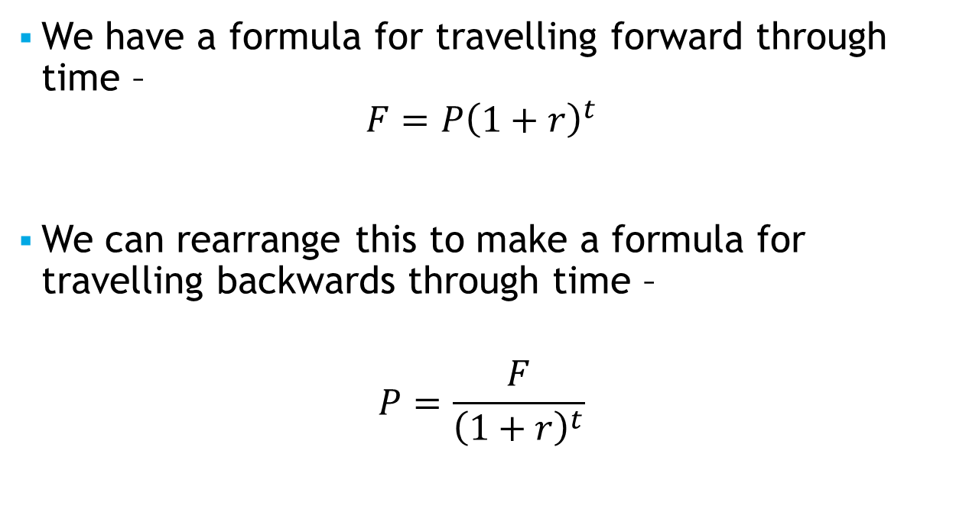
Backwards in Time
We have a formula for travelling forward through time –
$$F=P{\left(1+r\right)}^{t}$$
We can rearrange this to make a formula for travelling backwards through time –
$$P=\frac{F}{{\left(1+r\right)}^{t}}$$

Slide 4
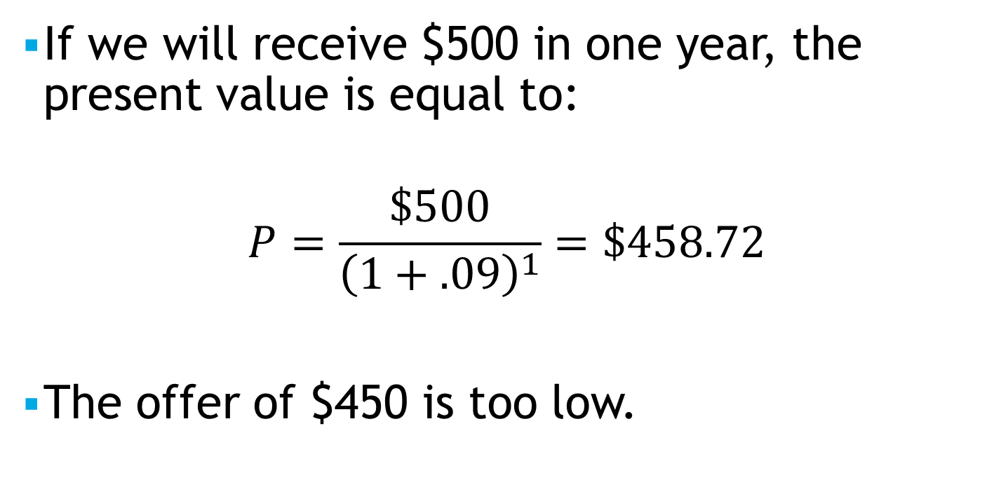
Our Example
If we will receive $500 in one year, the present value is equal to:
$$P=\frac{\$500}{{\left(1+.09\right)}^{1}}=\$458.72$$
The offer of $450 is too low.

Slide 5

Harder Example
We owe the bank $2.5 million in one year and another $5 million in three years.
The interest rate is 12%
What is the present value of these two payments to the bank?
$P=\frac{\$2.5}{{\left(1+.12\right)}^{1}}+\frac{\$5}{{\left(1+.12\right)}^{3}}=\$2.23+\$3.56=\$5.79$ Million

Slide 6
Takeaways
We revisited the notion that money at different moments has different values
We showed how to compute the present value of a payment received in the future

