Slide 1
NPV
Professor Brett A. Saraniti

Slide 2

Infinity
Now we can use what we’ve learned about summation, infinity, fractions, and present value to derive formulas from accounting & finance –
$$\sum_{t=1}^{∞}{\frac{A}{{\left(1+r\right)}^{t}}=}\frac{A}{{\left(1+r\right)}^{1}}+\frac{A}{{\left(1+r\right)}^{2}}+\frac{A}{{\left(1+r\right)}^{3}}+ …$$

Slide 3

Review
Earlier, we introduced a formula –
$$\sum_{t=1}^{∞}{X^{t}=\frac{X}{1−X } 0<X<1}$$
This is close but not exactly the same as our expression
$$\sum_{t=1}^{∞}{\frac{A}{{\left(1+r\right)}^{t}}}$$

Slide 4

Quick Edit
We can restate our expression so it fits the formula
$$\sum_{t=1}^{∞}{\frac{A}{{\left(1+r\right)}^{t}}}=A\left[\sum_{t=1}^{∞}{\frac{1}{{\left(1+r\right)}^{t}}}\right]=A\left[\sum_{t=1}^{∞}{{\left(\frac{1}{1+r}\right)}^{t}}\right]$$

Slide 5

The Brackets
$$\left[\sum_{t=1}^{∞}{{\left(\frac{1}{1+r}\right)}^{t}}\right]=\frac{1/{\left(1+r\right)}}{1−1/{\left(1+r\right)}}$$
$$\frac{1/{\left(1+r\right)}}{{\left(1+r\right)}/{\left(1+r\right)}−1/{\left(1+r\right)}}$$
$$\frac{1/{\left(1+r\right)}}{r/{\left(1+r\right)}}= \frac{1}{r}$$

Slide 6
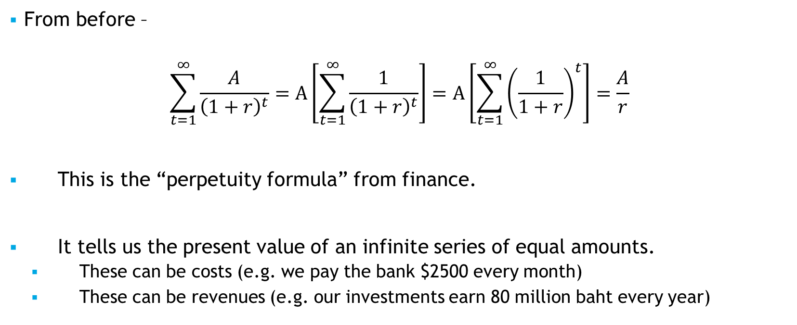
In Conclusion
From before –
$$\sum_{t=1}^{∞}{\frac{A}{{\left(1+r\right)}^{t}}}=A\left[\sum_{t=1}^{∞}{\frac{1}{{\left(1+r\right)}^{t}}}\right]=A\left[\sum_{t=1}^{∞}{{\left(\frac{1}{1+r}\right)}^{t}}\right]=\frac{A}{r}$$
This is the “perpetuity formula” from finance.
It tells us the present value of an infinite series of equal amounts.
  These can be costs (e.g. we pay the bank $2500 every month)
  These can be revenues (e.g. our investments earn 80 million baht every year)

Slide 7
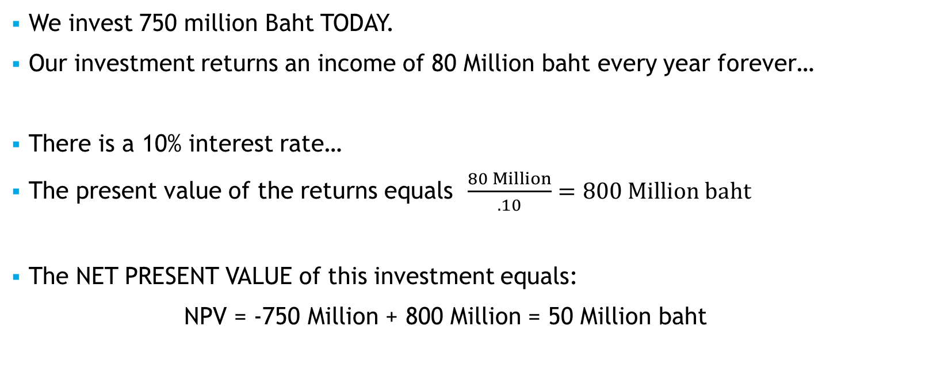
Quick Example
We invest 750 million Baht TODAY.
Our investment returns an income of 80 Million baht every year forever…
There is a 10% interest rate…
The present value of the returns equals $\frac{80 Million}{.10}=800 Million baht$
The NET PRESENT VALUE of this investment equals:
NPV = -750 Million + 800 Million = 50 Million baht

Slide 8
Takeaways
We derived the perpetuity formula
We introduced the concept of using NPV as an investment guide

