Slide 1
Excel
Professor Brett A. Saraniti

Slide 2
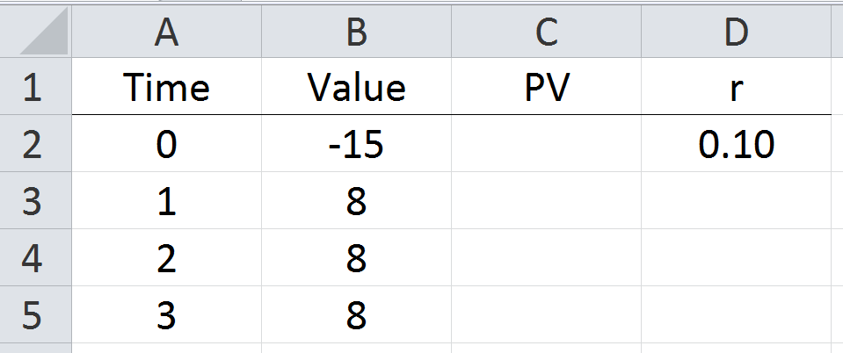
Example

Slide 3
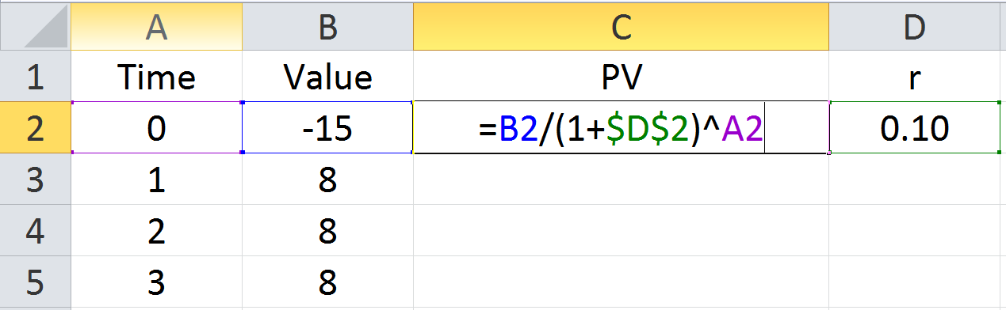
PV Formula in Excel

Slide 4
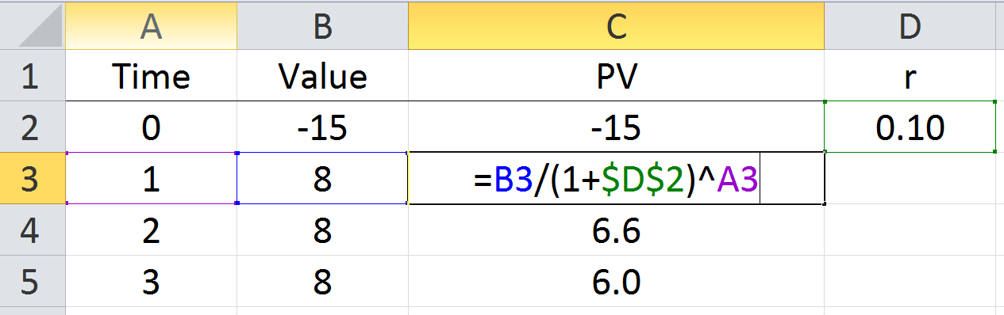
Copy & Paste the formula

Slide 5
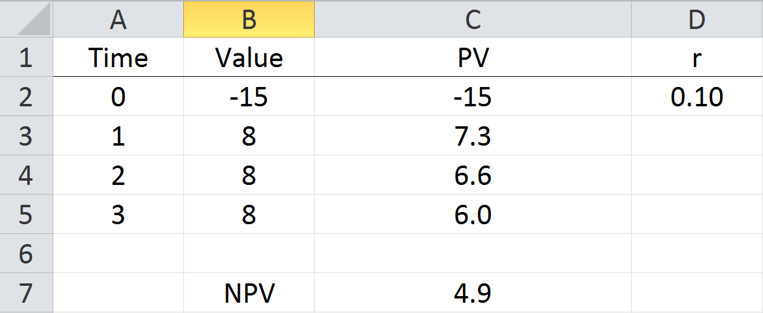
Net Present Value - NPV

Slide 6
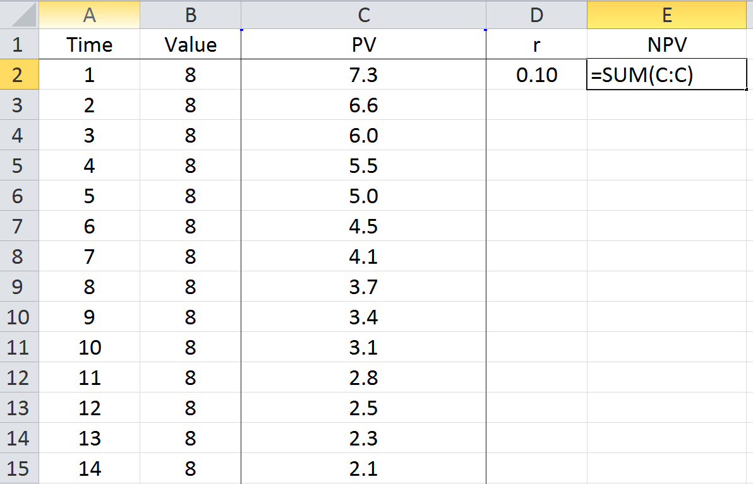
Approximate Perpetuity

Slide 7
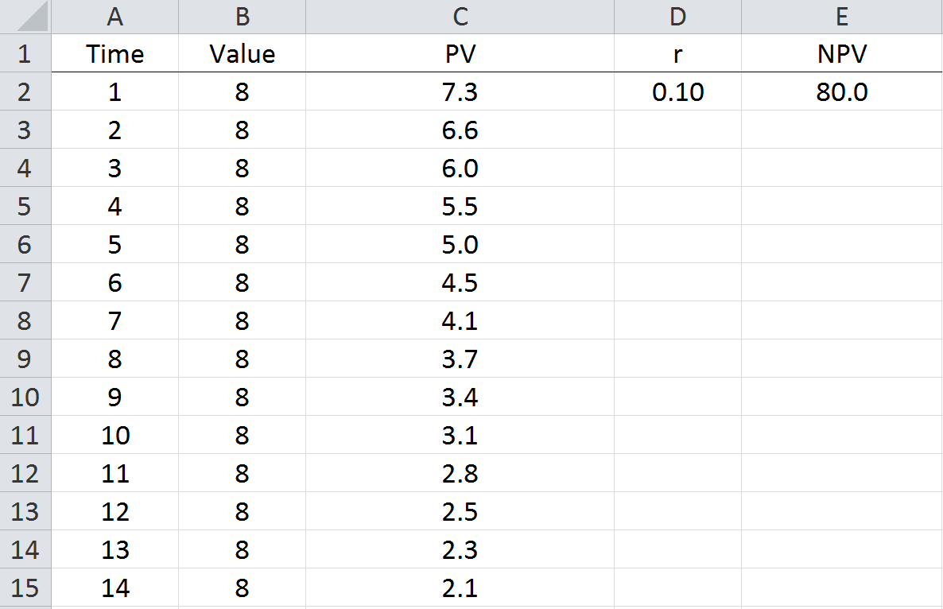
Same Results

Slide 8
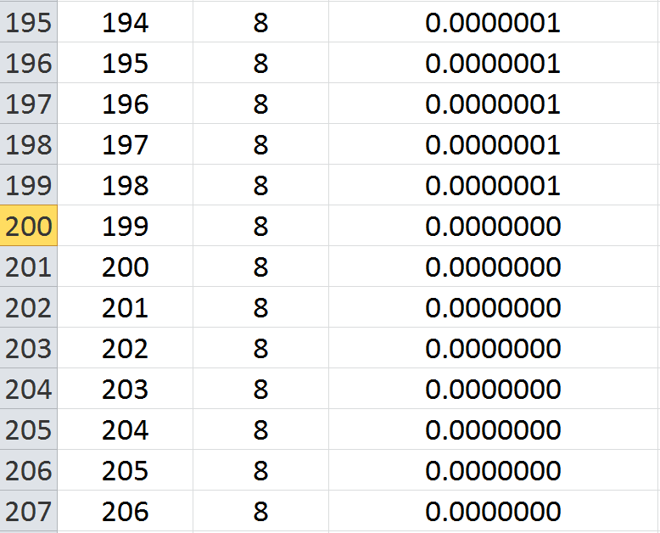
Why?

Slide 9
Takeaways
Excel is a useful tool for brute force calculations
Some financial formulas can easily be approximated using Excel

