Slide 1
Algebra
Professor Brett A. Saraniti

Slide 2

Linear Equations
Linear Equations only have variables raised to the first power
$50X=400$
$7Z – 19 =2Z + 31$
$Y=5X+150$

Slide 3

One Linear Equation with One Unknown Variable
$$50X=400$$
$$\frac{50X}{50}=\frac{400}{50}$$
$$X=8$$

Slide 4

Example
$$7Z – 19 =2Z + 31$$
$$7Z – 19−2Z=2Z + 31−2Z$$
$$5Z – 19= 31$$
$$5Z – 19+19= 31+19$$
$$5Z=50$$
$$\frac{5Z}{5}=\frac{50}{5}$$
$$Z=10$$

Slide 5

Inequalities
Inequalities function just like equations with a few exceptions
$$<$$
$$≤$$
$$>$$
$$≥$$

Slide 6

Numerical Examples
$$2<6$$
$$2≤3.5$$
$$10>4$$
$$4≥4$$

Slide 7
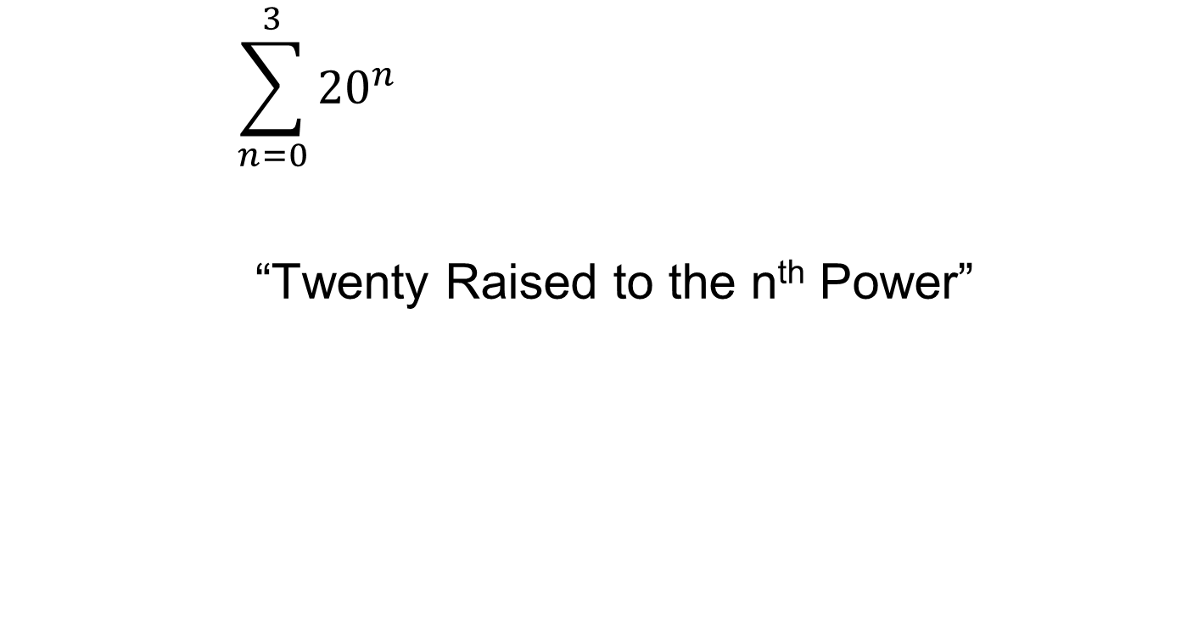
One Linear Inequality With One Unknown Variable
$$200X≤2600$$
$$\frac{200X}{200}≤\frac{2600}{200}$$
$$X≤13$$

Slide 8
Number Line
-10 -9 -8 -7 -6 -5 -4 -3 -2 -1
0 1 2 3 4 5 6 7 8 9 10
Greater
Lesser

Slide 9

Numerical Examples - Negatives
$$−2>−6$$
$$−2≥−3.5$$
$$−10<−4$$
$$−4≤−4$$

Slide 10
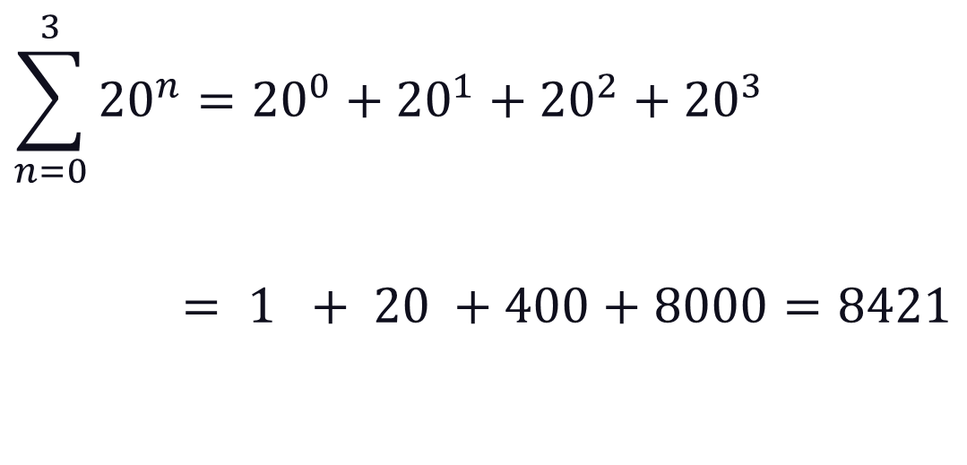
Negatives
$$20X+50≤30X+90$$
$$20X−30X ≤90−50$$
$$−10X≤40$$
$$X≥\frac{40}{−10}$$
$$X≥−4$$

Slide 11
Takeaways
We reviewed linear equations and inequalities
We stressed the reversal of order for negative inequalities

