Slide 1
Algebra Part II
Professor Brett A. Saraniti

Slide 2

Two Linear Equations with Two Unknown Variables
One linear equation with two unknown variables
(1) $X+2Y=150$
Solution(s) to (1)
  $$X=150, Y=0$$
  $$X=100, Y=25$$
  $$X=0, Y=75$$

Slide 3
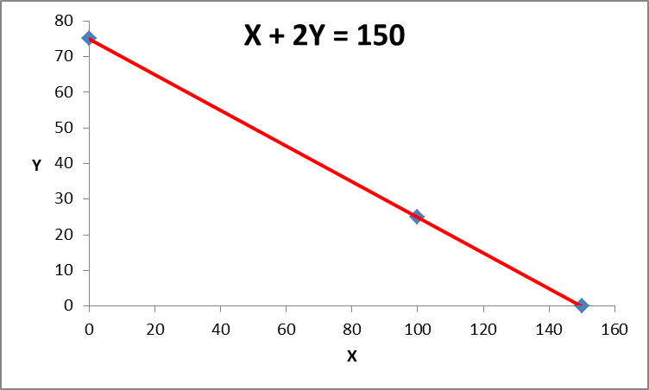
Visualizing

Slide 4

Two Linear Equations with Two Unknowns
(1) $X+2Y=150$
(2) $−X+ 3Y = 30$
Solution(s) to (2)
  $$X=−30, Y=0$$
  $$X=60, Y=30$$
  $$X=0, Y=10$$

Slide 5
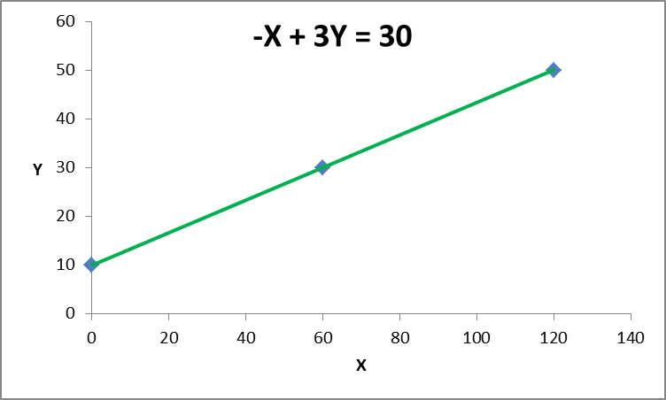
Visualizing

Slide 6
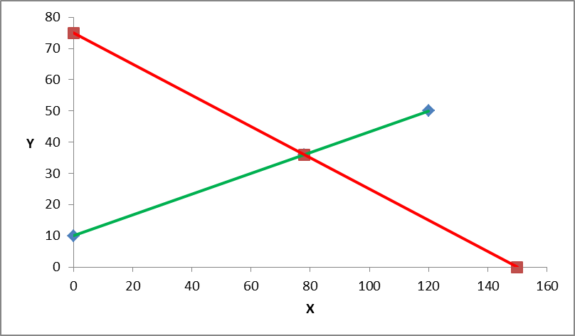
One Solution

Slide 7
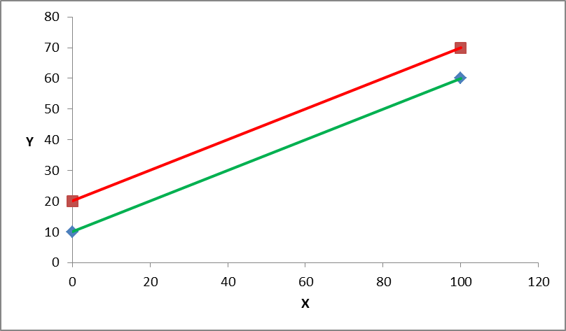
Rare Exception: Parallel Lines

Slide 8

Two Linear Equations with Two Unknowns
(1) $X+2Y=150$
$\left(2\right) −X+ 3Y = 30$

Slide 9
Graphical Solution

Slide 10

Algebra Solution 1: Elimination
$$X+2Y=150$$
$$−X+ 3Y = 30$$
$$5Y=180$$
$$\frac{5Y}{5}=\frac{180}{5}$$
$$Y=36$$
$$X+2\left(36\right)=150$$
$$X=150−72=78$$

Slide 11

Algebra Solution 2: Substitution
(1) $X+2Y=150$
$2Y =150−X$
$Y=75−\frac{1}{2}X$

Slide 12

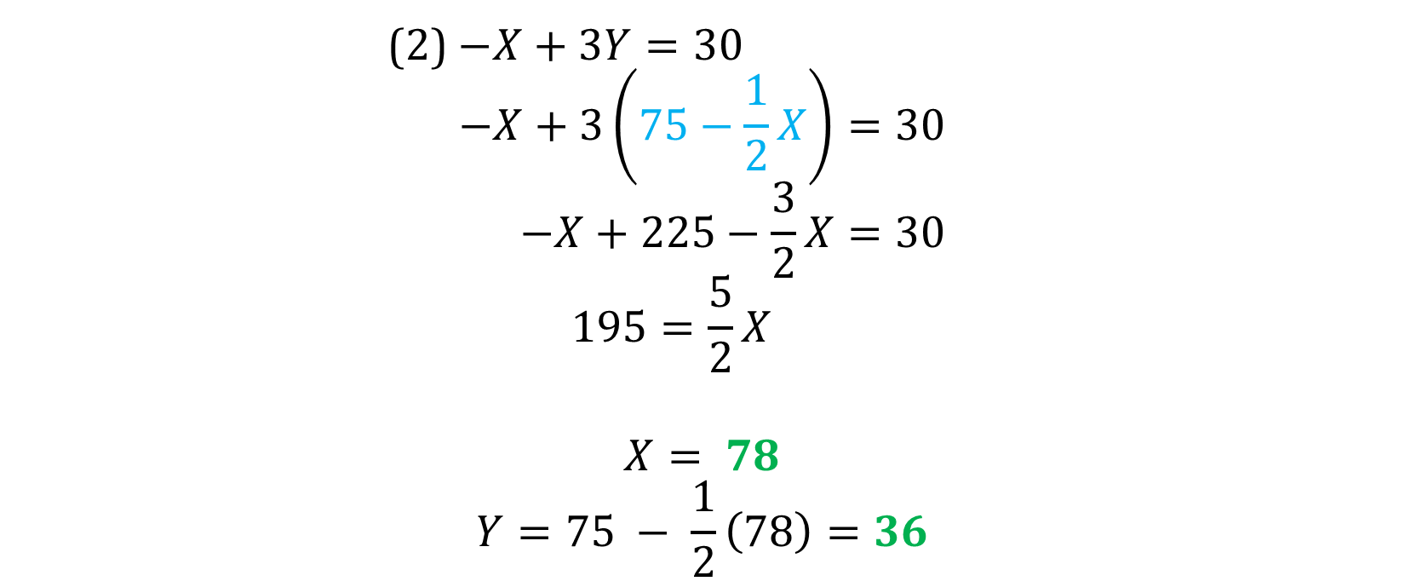
Substitution Continued
$$Y=75−\frac{1}{2}X$$
(2) $−X+3Y=30$
$$−X+3\left(75−\frac{1}{2}X\right)=30$$
$$−X+225−\frac{3}{2}X=30$$
$$195=\frac{5}{2}X$$
$$X= 78$$
$$Y=75 − \frac{1}{2}\left(78\right)=36$$

Slide 13

Slope Intercept Form
$X+2Y=150$
$2Y=−X+ 150$
$Y=− \frac{1}{2}X+75$ $Y=mX+b$
b, the intercept
m, the slope

Slide 14
Takeaways
We showed how to solve a pair of linear equations using three different methods
We reviewed slope-intercept form of a line

