Slide 1
Non-Linear Equations
Professor Brett A. Saraniti

Slide 2
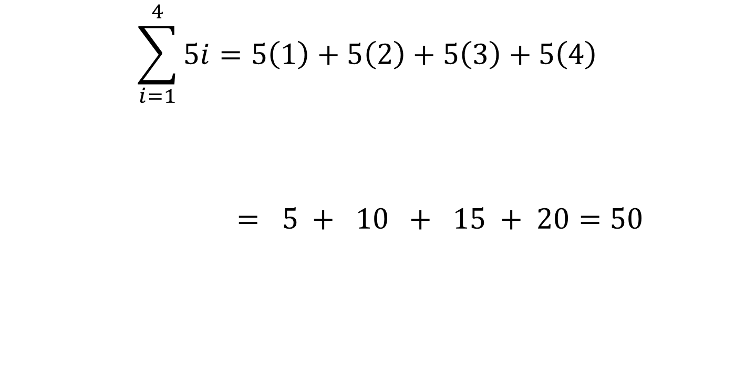
Quadratic Equations
Quadratic Equations have one or more variables raised to the 2nd power.
$X^{2}=1$6
$X^{2}=0$
$X^{2}=−1$

Slide 3

Factoring
$X^{2}−7X+6=0$
$(X−1)(X−6)=0$
So either $(X−1)=0$ or $(X−6)=0$
Thus X = 1 or 6
Formal Notation: $X∈\left\{1,6\right\}$

Slide 4
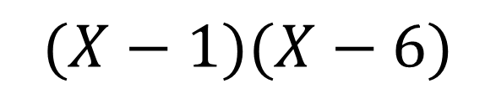

Challenge
$(X−1)(X−6)=0$
$X^{2}−6X−1X+6=0$
F O I L
$X^{2}−7X+6=0$
$$(X−1)(X−6)$$

Slide 5


Quadratic Formula
${1X}^{2}−7X+6=0$
a=1, b=-7, c=6
$X=\frac{7±\sqrt{49−4(1)(6)}}{2(1)}$
$X=\frac{7±5}{2}= \frac{2}{2}or\frac{12}{2}$
Thus X = 1 or 6
${aX}^{2}+bX+c=0$
$X=\frac{−b±\sqrt{{b }^{2}−4ac}}{2a}$

Slide 6
Other Non-Linear Functions
The logarithm is a widely used non-linear function
Many non-linear patterns appear linear on a “log scale”
A log transform becomes very important in data analysis

Slide 8

Log Functions
$Y=aX^{b}$
$log$Y = $log (aX^{b})$
= $log a+logX^{b}$
= $log a+b logX$
$log$Y = $log a+b logX$

Slide 9

Types of Logs
Base 10 Log → $\log_{10}{X}$
  Think “What number do I raise 10 to in order to get X”
  E.g. $\log_{10}10,000=4$
Natural Log → base “e” → lnX
  Think “What number do I raise “e” to in order to get X”
  E.g. ln(e) = 1

Slide 10

e
e = 2.7182818284590…
e is called the exponential function.
It is irrational like $π$ and it shows up everywhere in nature
(and also in business school.)

Slide 11
Takeaways
We examined quadratic and logarithmic equations
We introduced the irrational number “e”

